Slide 1
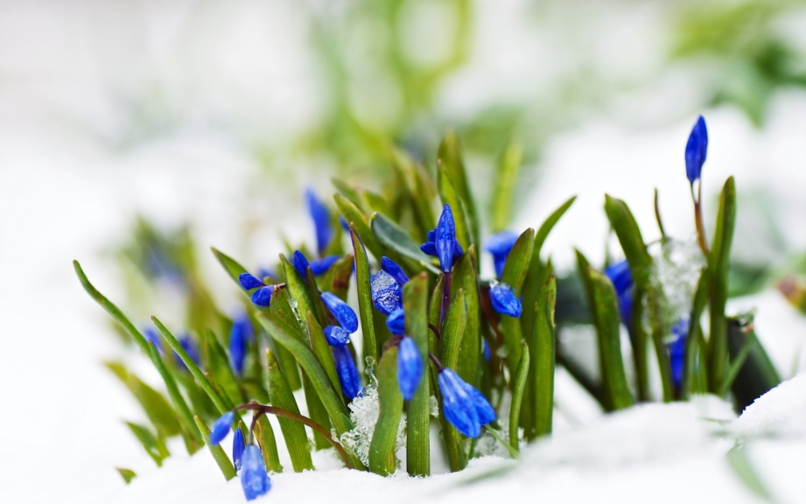
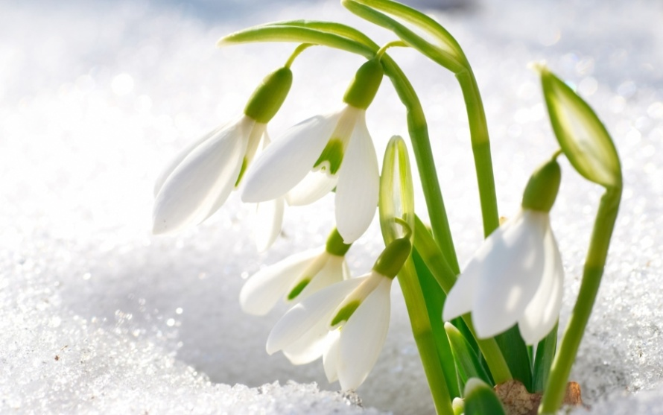
Spring is coming soon. My favourite season is spring. The weather is good, it’s warm and the sun is shining.

Slide 2
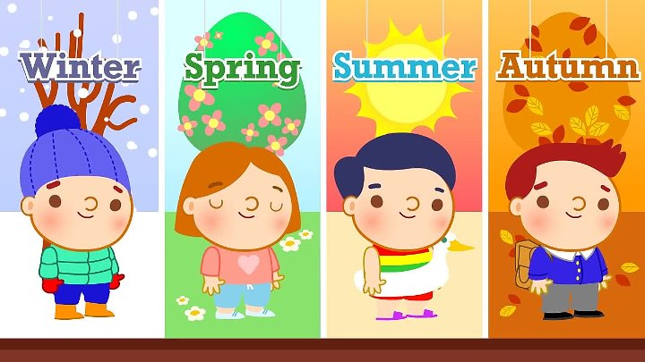
What is your favourite season?

Slide 3

Peter and Ann like to travel. They are in different countries.

Slide 4
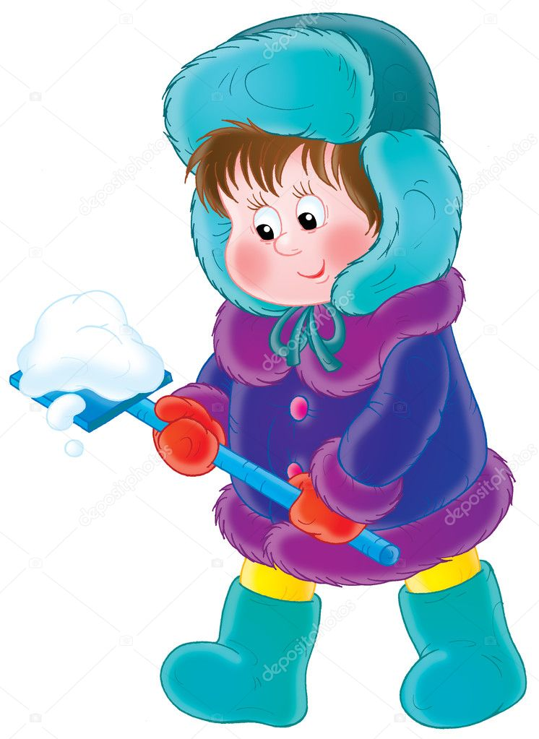

Peter is in India. It is very hot there. How do you think what clothes is suitable (подходящий)?

Slide 5
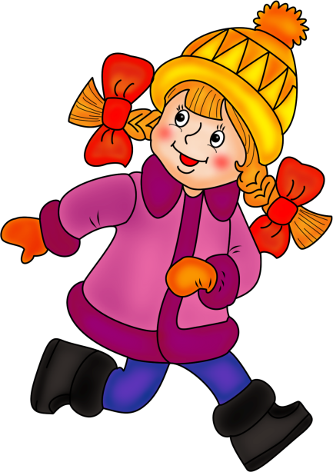
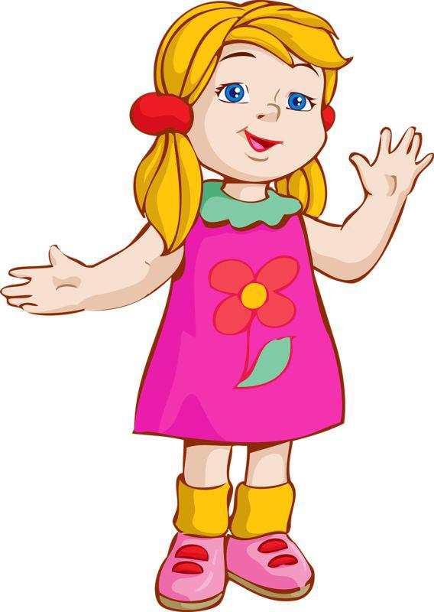
Ann is in Alaska. It is very cold there. How do you think what clothes is suitable?

Slide 6
1) What’s the weather like today?
2) Are your clothes suitable for the weather?
3) What is the topic of our lesson?

Slide 7
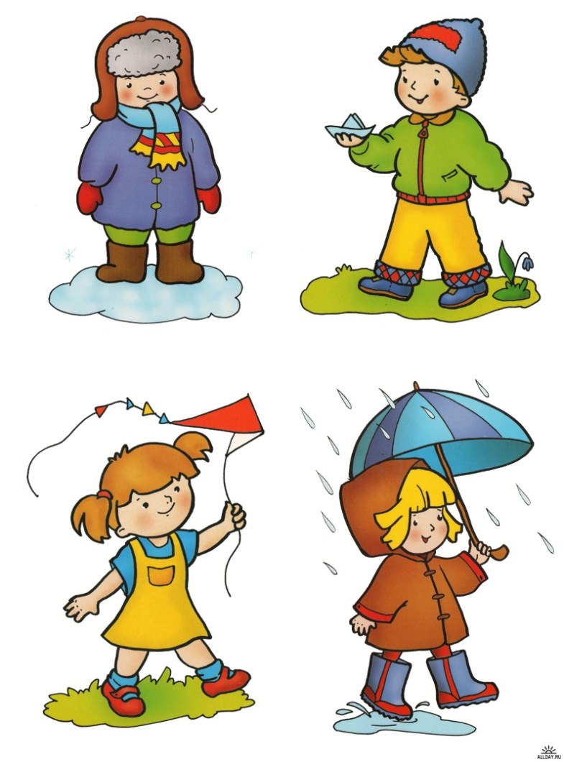
The topic of our lesson is
«Dress right»

Slide 8

What is the aim of our lesson?

Slide 9
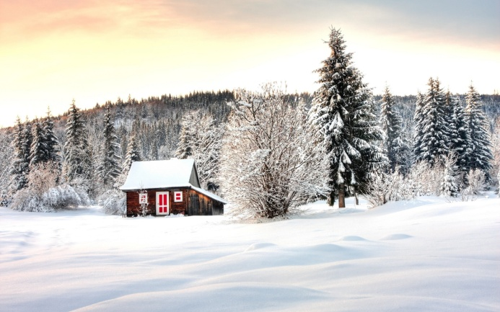
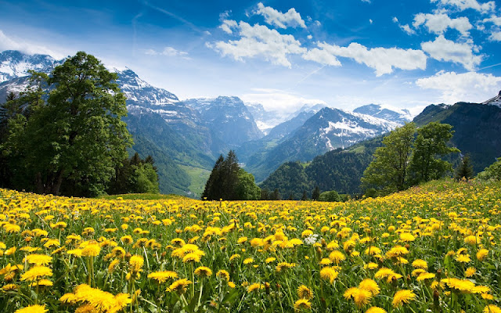
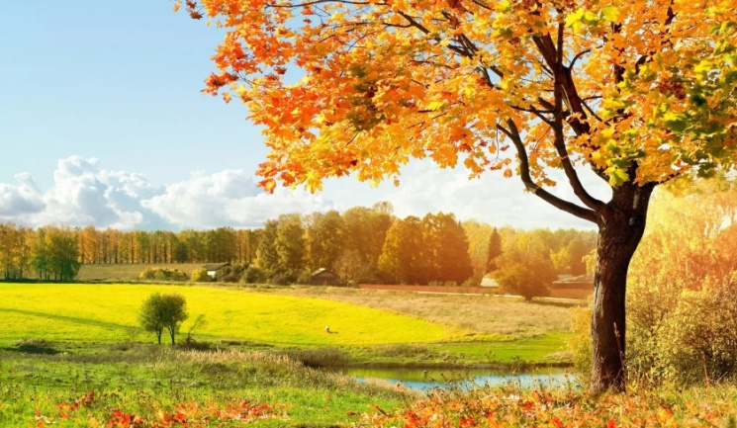
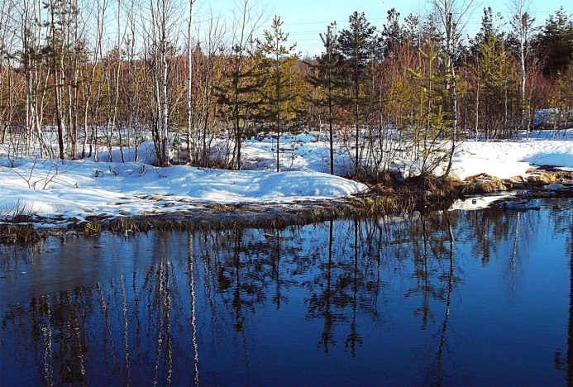
1) What do you usually wear in winter?
2)What do you usually wear in summer?
3)What do you usually wear in spring?
4) What do you usually wear in autumn?
Model: I usually wear a T-shirt in summer.

Slide 10
Game
The first student describes the weather; the second student suggests (предлагать, советовать) clothes to put on.
S1: It’s raining today.
S2: Put on your raincoat.

Slide 11

There are many guidebooks(путеводитель). Why do we need the guidebooks?

Slide 12
Make New York guidebook.
(describe the weather and the clothes).

Slide 13




Work together.
Be attentive on (внимательный) each other.
Follow the plan.
Keep on time.

Slide 14
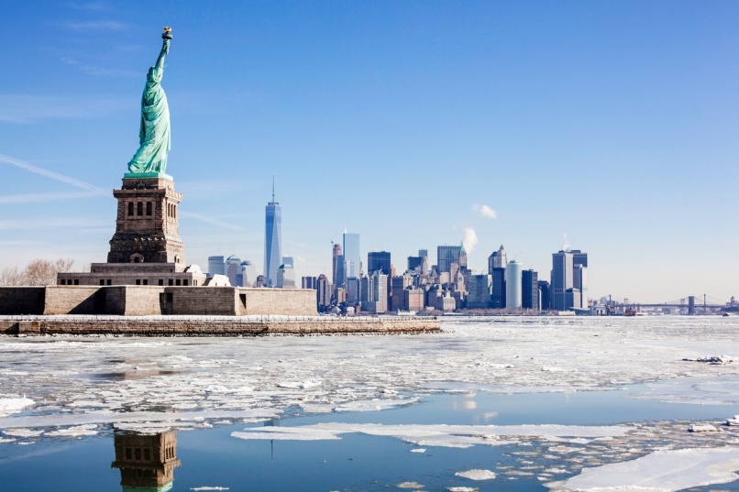
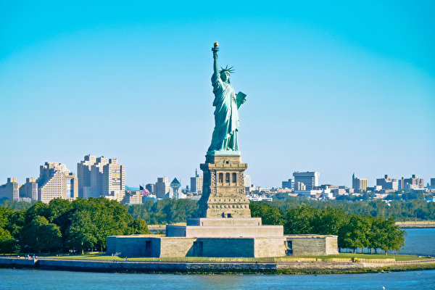
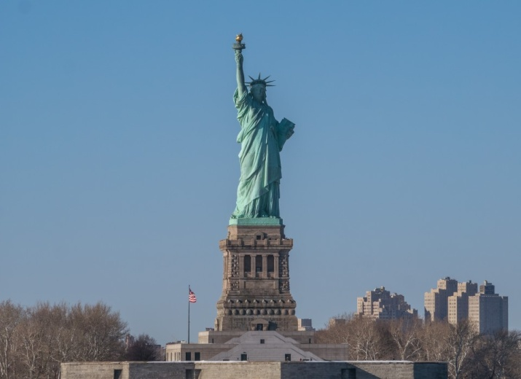
When is it better to visit New York?

Slide 15



Выберите стикер, который соответствует вашему настроению после урока, и поместите его на доске.
Я доволен собой, у меня все получилось! | Мне почти все удалось. | Сегодня не мой день! Впереди еще много работы над собой.

