Slide 1
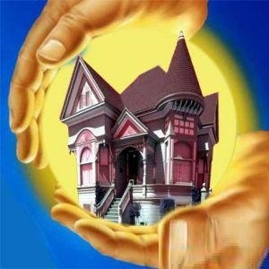
My home is my castle.

Slide 2
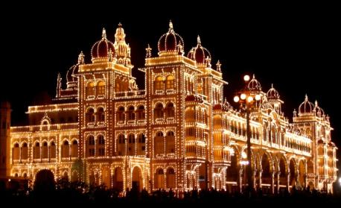
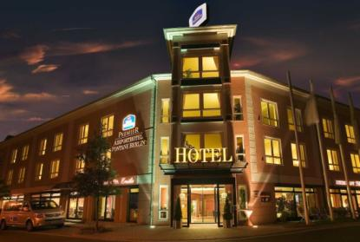
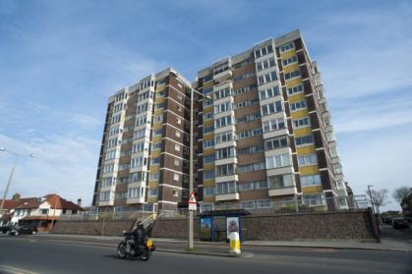
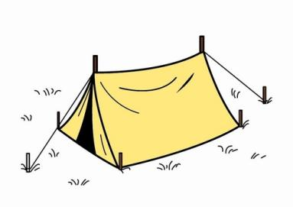
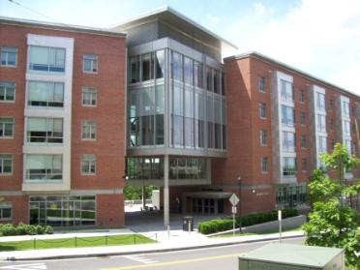
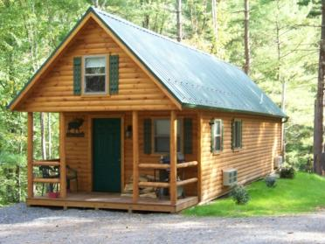
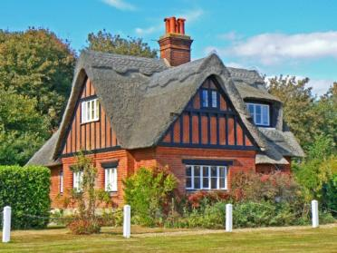
Palace
Hotel
Dwellings
Block of flats
Tent
University halls of residence
House
Cottage

Slide 3
Hands up! Clap! Clap! Clap!
Hands down! Shake! Shake! Shake!
Hands on hips! Jump! Jump! Jump!
Hop! Hop! Hop! Stand still!

Slide 4
(правило, долг)
(запрещено)
(не разрешается)
must
mustn’t
can’t
You must keep the room clean.
You mustn’t eat in class.
You can’t listen to music at night.

Slide 5
Homework
Workbook – P. 47 №1-3;

Slide 6
Я узнал …
Я смог …
Было сложно …

