Slide 1
Презентация к обобщающему уроку Английского языка в 7 классе на закрепление темы модуля 3
(УМК ’’Spotlight’’)

Slide 2
Tasks for our lesson
1. Повторение пройденного материала по 3 Модулю
2. Talking about job and hobbies

Slide 3
Cross the odd word out.
1) bald – young – teenager – elderly
2) slim – plump – freckles – well-built
3) straight – wavy – curly – middle-aged
4) pretty – cute- short– ugly

Slide 4
Check your answers
1) bald
2) freckles
3) middle-aged
4) short

Slide 5
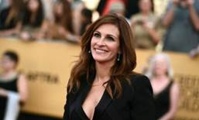
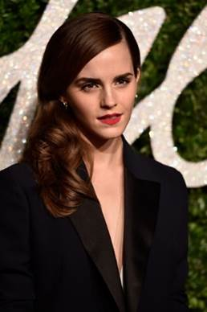
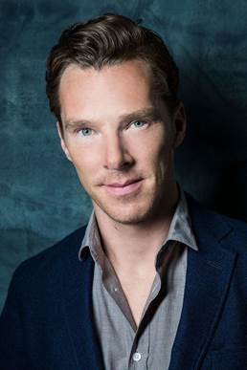
Задание: Опишите 4 людей по образцу, используя слова урока.
Образец: Julia Roberts (54 years, 175 centimeters)
Julia Roberts is 54(Julia Roberts is middle-aged). She is tall and slim. She has got long wavy brown hair. Her face is pretty. Her eyes are brown. She has got full lips and beautiful smile.
2) Benedict Cumberbatch (46 years, 183 centimeters)
1) Emma Watson (32 years, 165 centimeters)

Slide 6
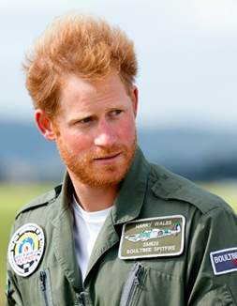
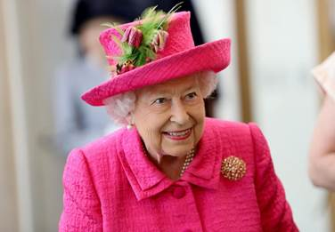
Образец: Julia Roberts (54 years, 175 centimeters)
Julia Roberts is 54(Julia Roberts is middle-aged). She is tall and slim. She has got long wavy brown hair. Her face is pretty. Her eyes are brown. She has got full lips and beautiful smile.
3) Queen Elizabeth II (96 years, 163 centimeters)
4) Prince Harry (37 years, 189 centimeters)

Slide 7
Fill in the gaps. • fit • patient • determined • sociable
1) John doesn’t get upset easily. He is ______.
2) Jenny loves parties, she is very ________.
3) Matt doesn’t give up easily. He is very ____________ to succeed.
4) Kate is very _____________. She spends all her free time at the gym.

Slide 8
Check your answers
1) patient
2) sociable
3) determined
4) fit

Slide 9
Choose the correct word.
1) King Henry VIII first introduced Beefeaters in 1485 when/who he used them as bodyguards.
2) These days though, their main role is to act as guides for the many tourists that/where visit the Tower every year.
3) They also take care of the eight big black ravens that/when live in the tower.
4) No one is exactly sure that/where the name “Beefeater” comes from.
5) All the Yeoman Warders are men who/that were in the armed forces for 22 years or more.

Slide 10
Check your answers
1) when
2) that
3) that
4) where
5) who

Slide 11
Choose the correct word.
1) The movie was really scared/scaring .
2) Tim was tiring/tired after the trip.
3) They were really disappointing/disappointed with the news.
4) Our skype conference was very bored/boring .

Slide 12
Check your answers
1) scaring
2) tired
3) disappointed
4) boring

Slide 13
Fill in the gaps. • for • back • up • with • of
1) Don’t give ________ even if you fail the test.
2) I gave Jane her book _______.
3) I lost control __________ my car. It was scary.
4) We will help you to cope ___________ your problems.
5) She is very famous __________ her poems.

Slide 14
Check your answers
1) up
2) back
3) of
4) with
5) for

Slide 15
Complete the phrase….
1. is someone who helps sick animals.
2. is someone who repairs cars.
3. is someone who teaches kids.
4. is someone who works in a library.
5. is someone who stars in plays or films.
A vet
A mechanic
A teacher
A librarian
An actor

Slide 16
Guess the jobs (p.32 ex.1-2)
1. I can take people letters and cards and parcels.
2. I can cook nice dishes at a restaurant.
3. I can carry your deliveries everywhere.
4. I can teach kids new things at school.
5. I can treat you when you have a toothache.
6. I can serve you food and drinks.
7. I can catch the thieves and robbers.
8. I can treat your pets and animals.
A postman
A cooker
A delivery boy
A teacher
A dentist
A waiter
A policeman
A vet

Slide 17
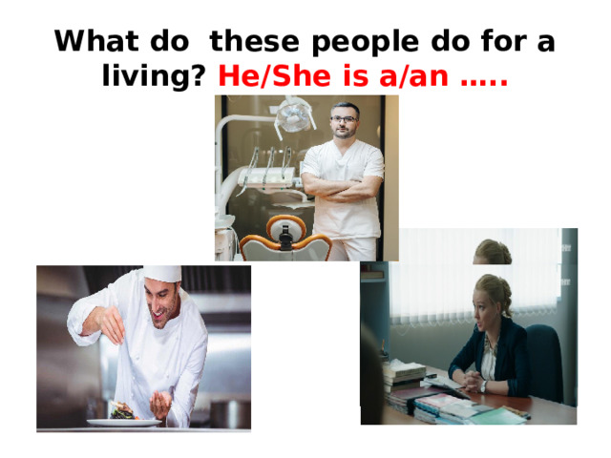

Slide 18
Еx.2 P. 32 (прослушать фразы, вставить в фразы в диалог и прочитать диалог)

Slide 19
Hometask
1. Составить описание друга
2. Выучить диалог с. 32 по ролям
3. Выучить записи в тетради

