Slide 1
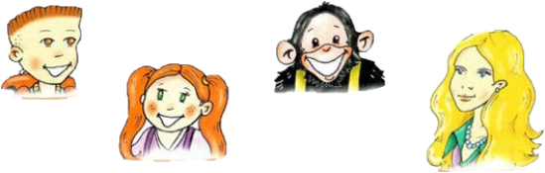
H e l l o !
Chuckles
Larry
Lulu
Nanny Shine

Slide 2

H e l l o !
Chuckles
Larry
Lulu
Nanny Shine

Slide 3
H e l l o !
Chuckles
Larry
Lulu
Nanny Shine
brother
sister

Slide 4
I`m …
This is …

Slide 5
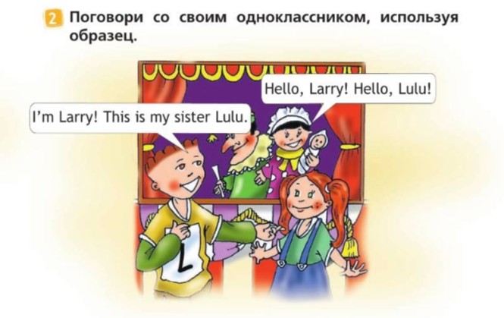

Slide 6
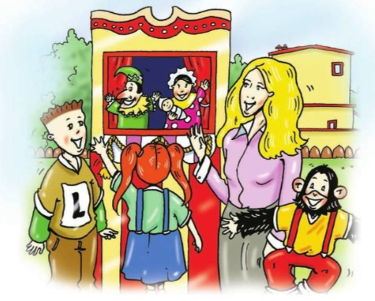
Judy
Punch

Slide 7
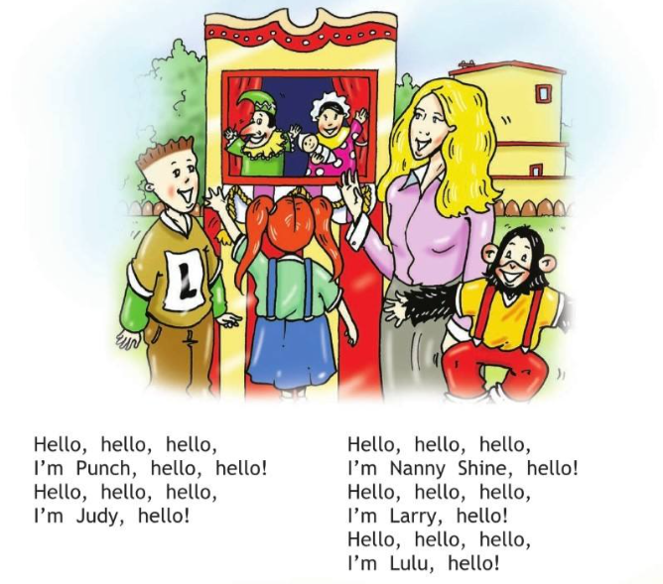

Slide 8
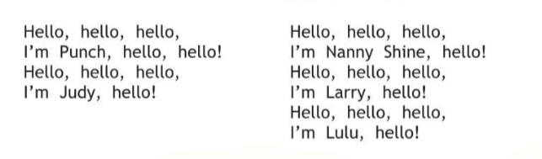

Slide 9
Judy
What`s his name?
Punch
His name is Punch.
What`s her name?
Her name is Judy

Slide 10
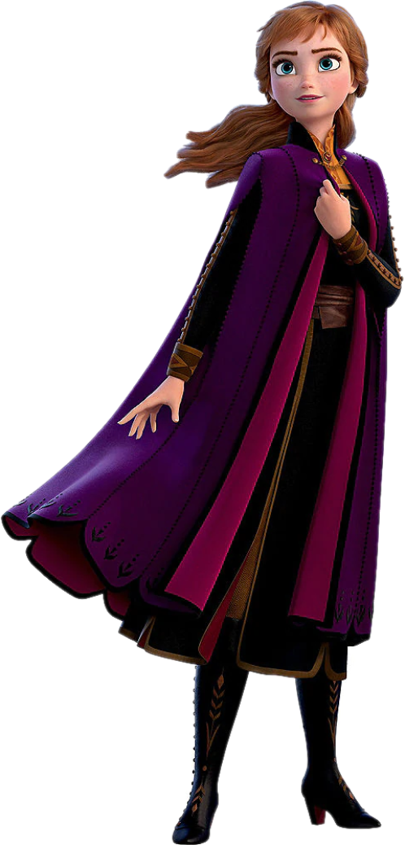

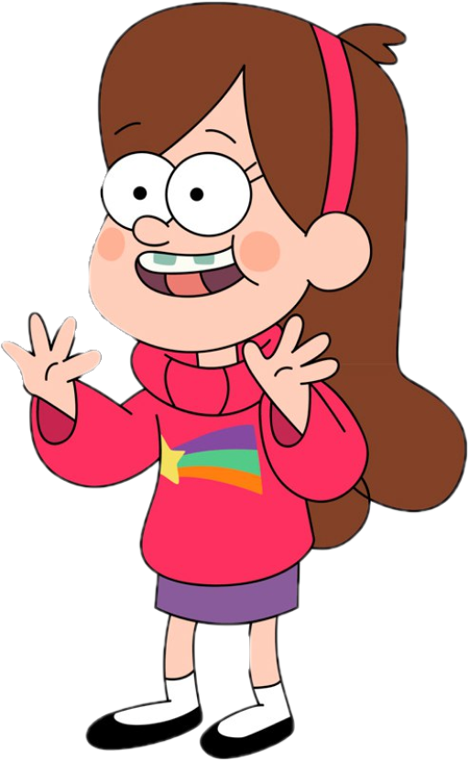
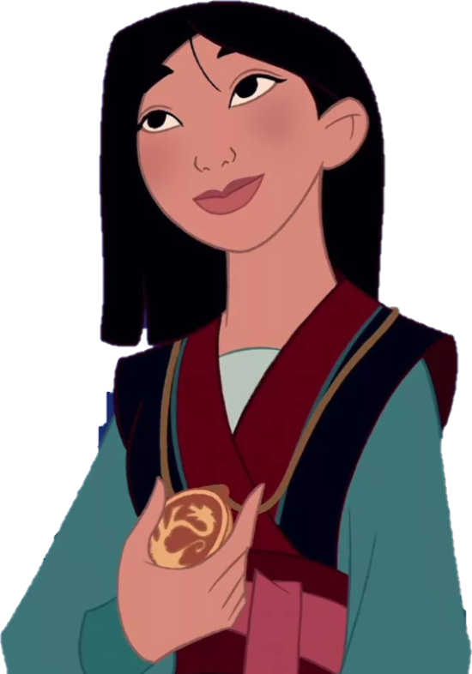
What`s her name?
Her name is …
Mulan
Anna
Wendy
Mable

Slide 11




What`s his name?
His name is ...
Dipper
Tom
Jerry
Mikey

Slide 12

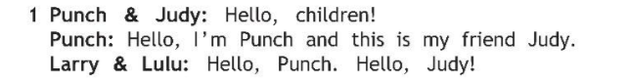
Judy
Punch
This is …

Slide 13
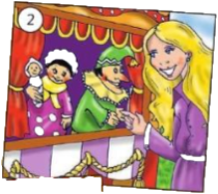
Judy
Punch
Nanny Shine
This is …

Slide 14
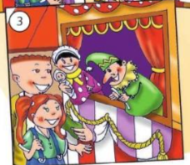

Larry
This is …
Luly

Slide 15
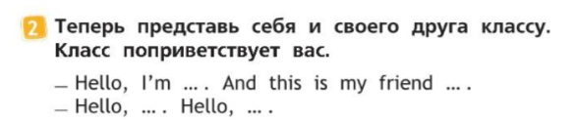

Slide 16




This is my …
Pen
Pencil
Book
Workbook

Slide 17
Goodbye!

