Slide 1
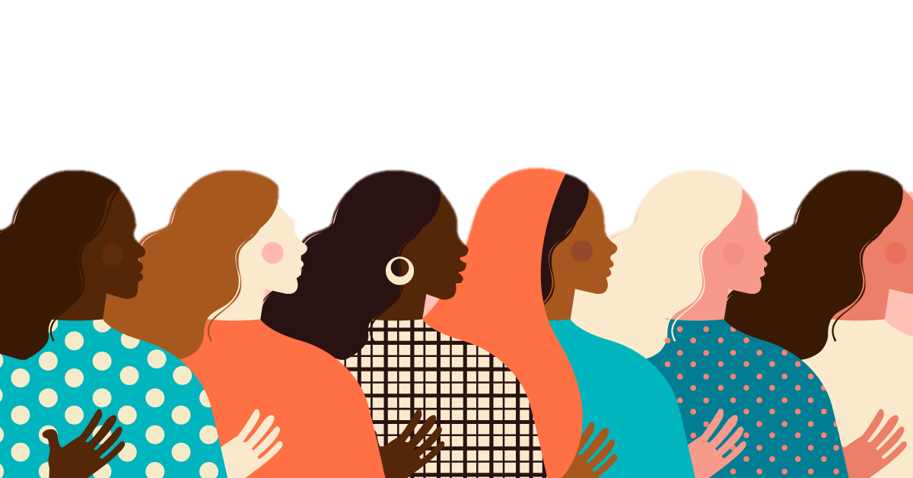
INTERNATIONAL
WOMEN’S DAY

Slide 2
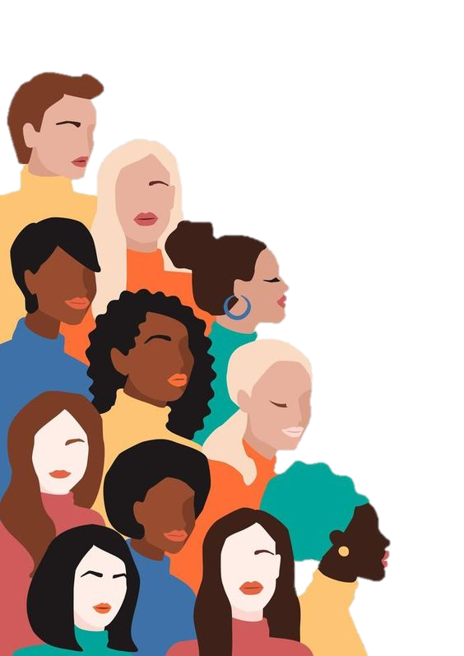
INTERNATIONAL
WOMEN’S DAY

Slide 3
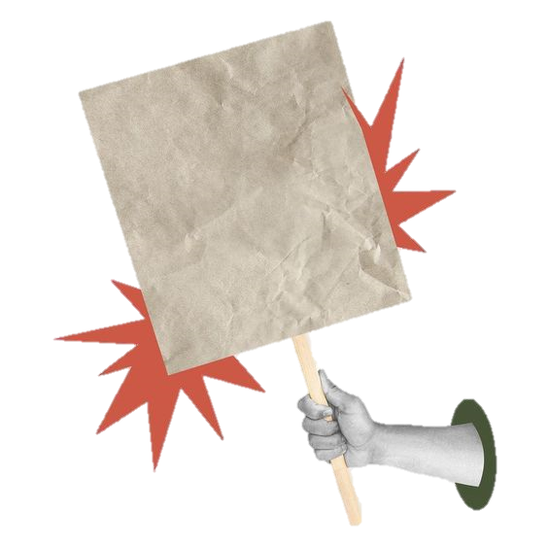
8 March
8
March
is a day to celebrate the social, economic and political achievements of women who have fought for their rights and gender equality.
INTERNATIONAL
WOMEN’S DAY

Slide 4
is a day to celebrate the social, economic and political achievements of women who have fought for their rights and gender equality.
8
March
Достижения в сфере общества, экономики и политики

Slide 5
is a day to celebrate the social, economic and political achievements of women who have fought for their rights and gender equality.
8
March
Боролись за свои права и равенство
Достижения в сфере общества, экономики и политики

Slide 6



QUIZE

Slide 7
QUIZE

Slide 8
Professions
Pilot
Actress and inventor
Writer
Scientist
Poet
Volunteer
Astronaut
Doctor
QUIZE

Slide 9
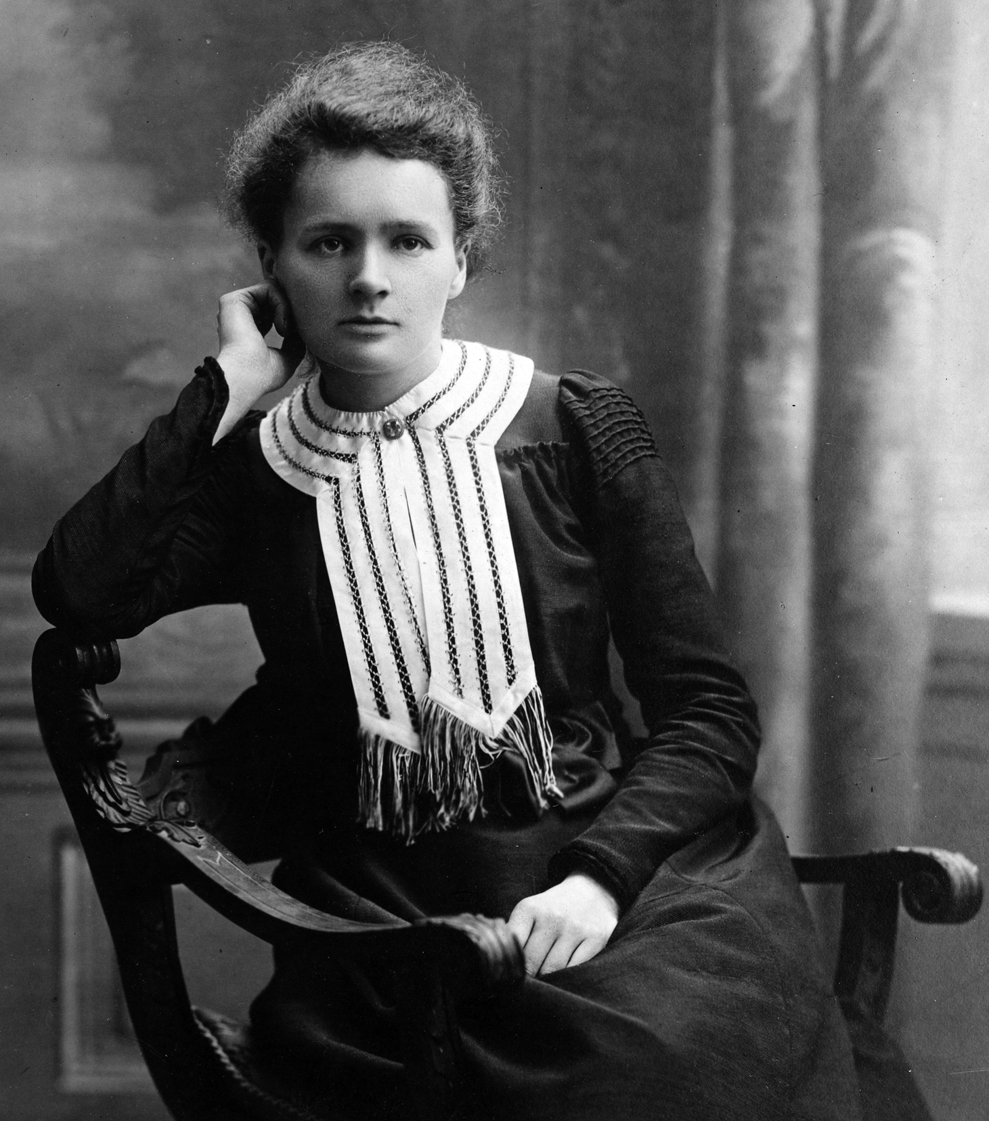
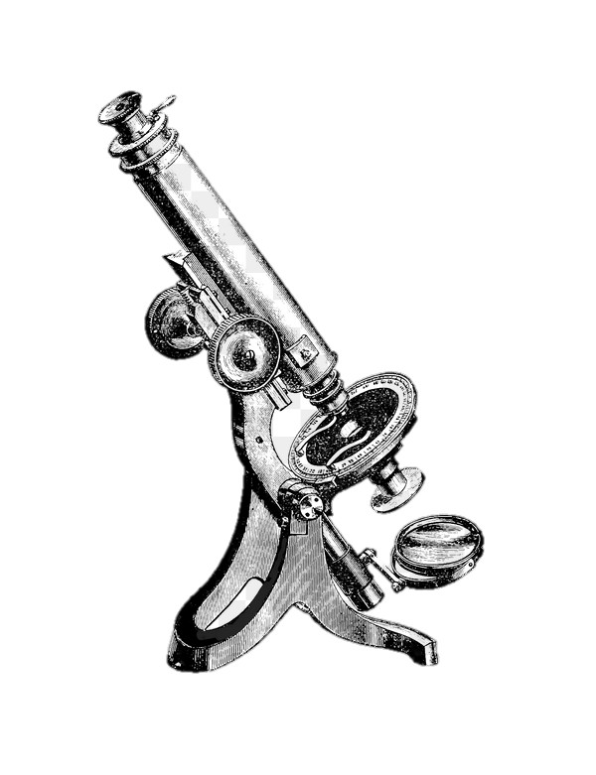
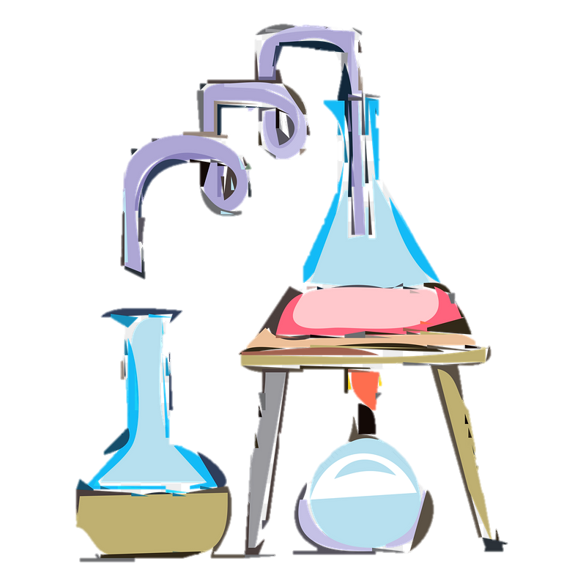
Pilot
Writer
Poet
Astronaut
Actress and inventor
Scientist
Volunteer
Marie Curie
Doctor

Slide 10
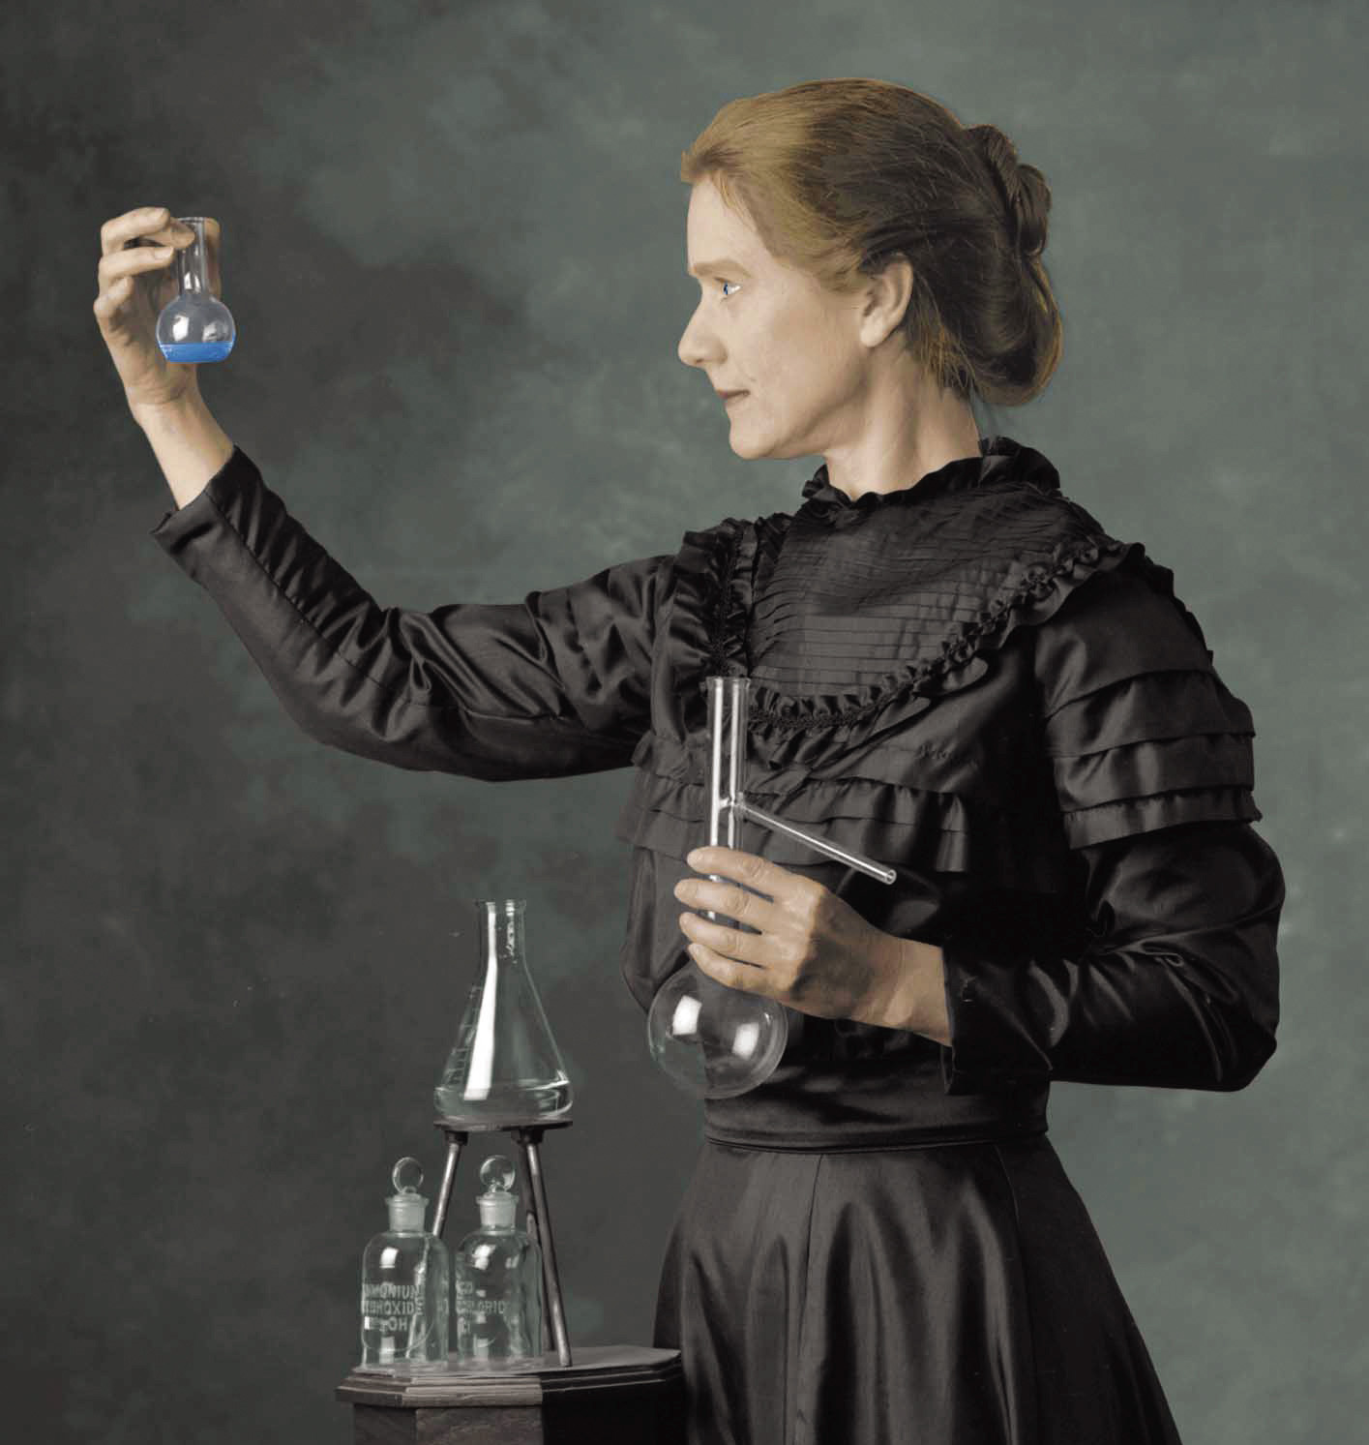

Known for her work on radioactivity, she became the first woman to receive the Nobel Peace Prize
Marie Curie

Slide 11
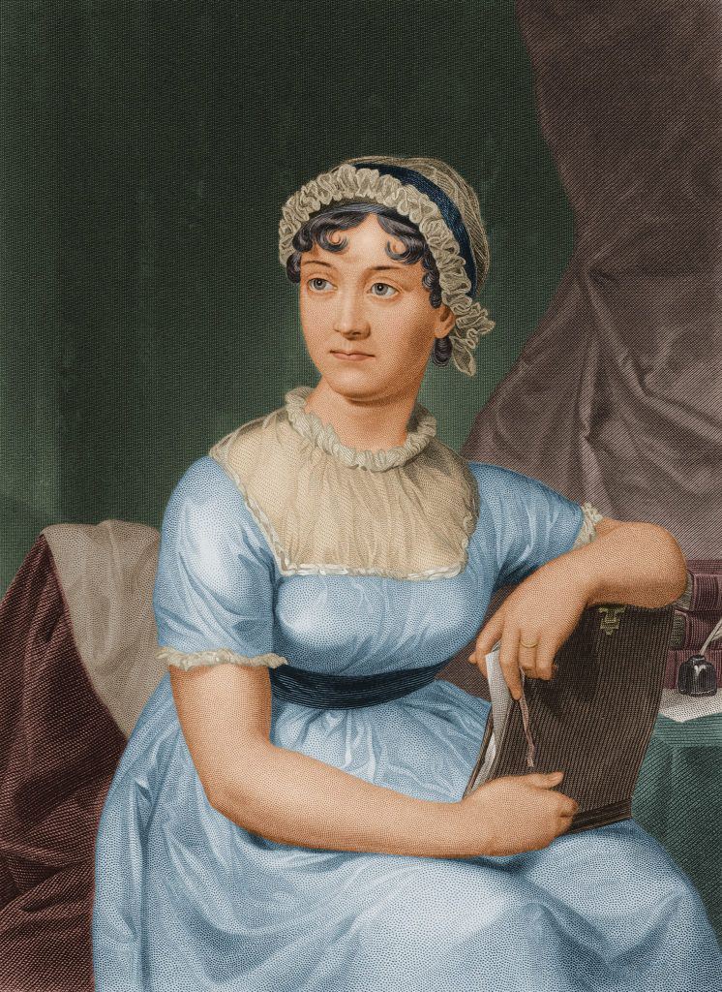
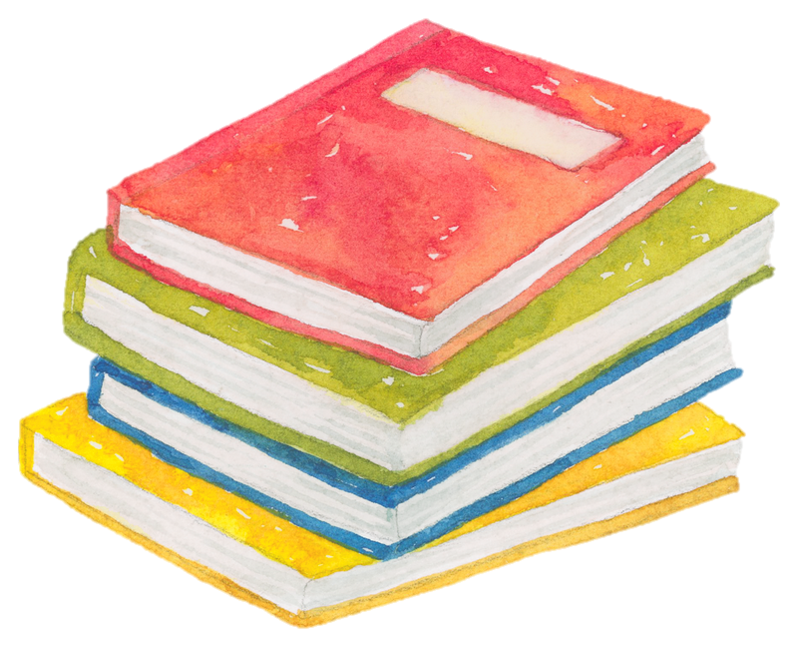
Pilot
Writer
Poet
Astronaut
Actress and inventor
Scientist
Volunteer
Jane Austen
Doctor

Slide 12
An English writer known for her books about women’s lives in 19th century
Jane Austen

Slide 13
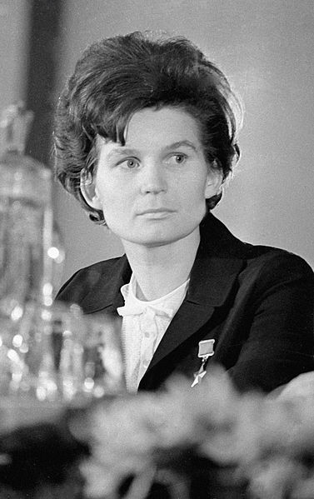
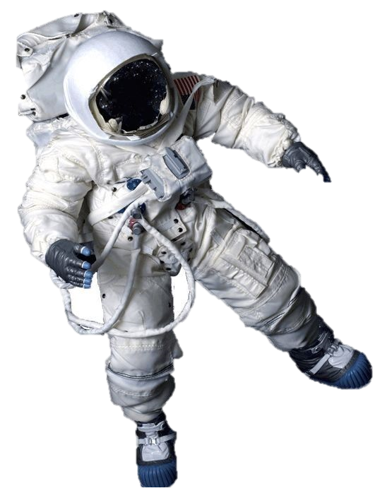
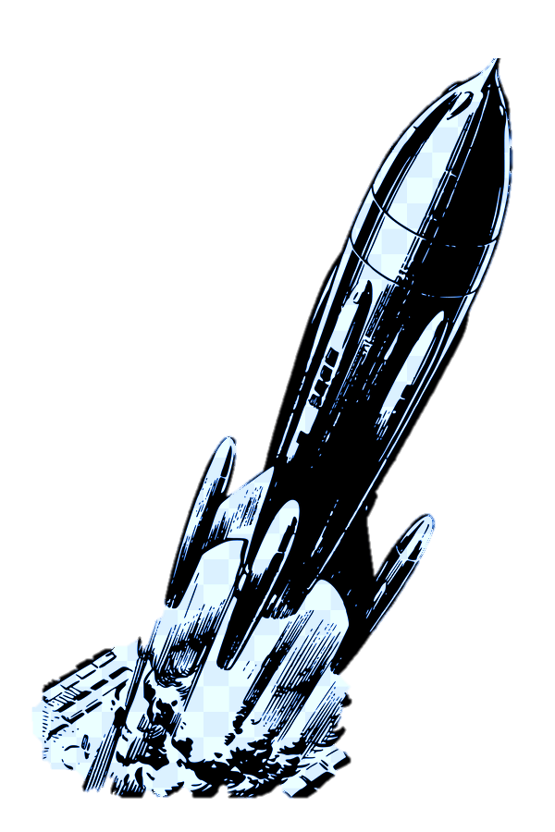
Pilot
Writer
Poet
Astronaut
Actress and inventor
Scientist
Valentina Tereshkova
Volunteer
Doctor
Это изображение, автор: Неизвестный автор, лицензия: CC BY-SA

Slide 14
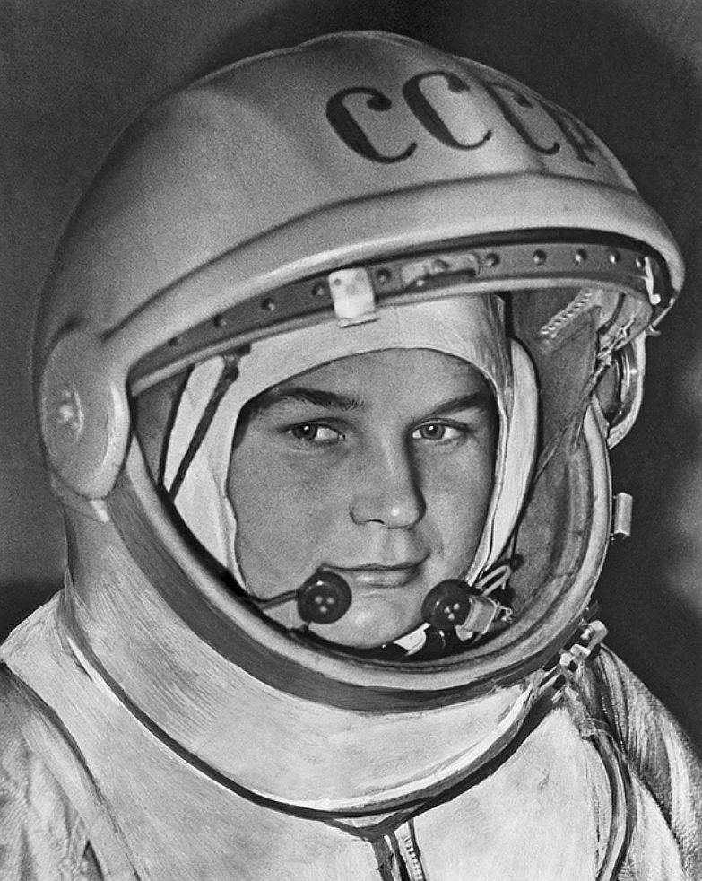
The first woman to fly in the space
Valentina Tereshkova

Slide 15
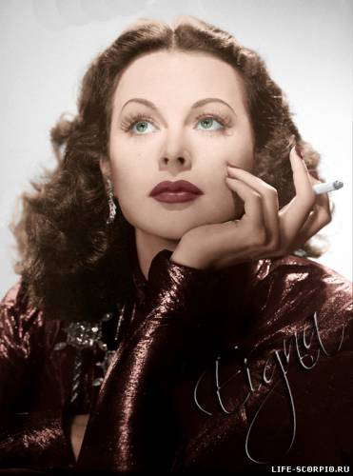
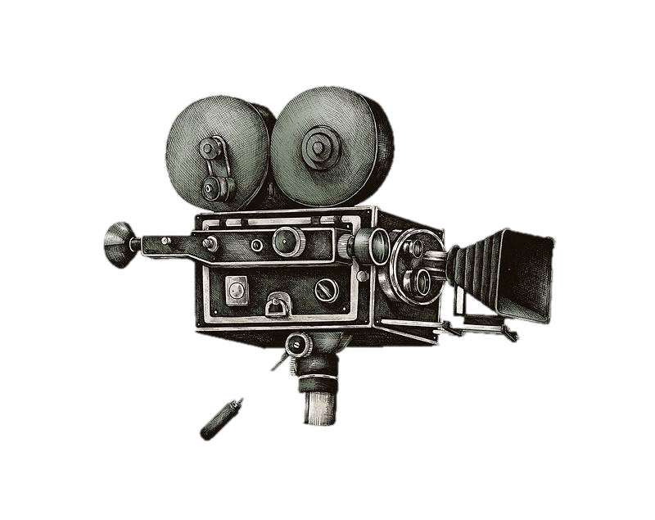


Pilot
Writer
Poet
Astronaut
Actress and inventor
Scientist
Volunteer
Hedy Lamarr
Doctor

Slide 16
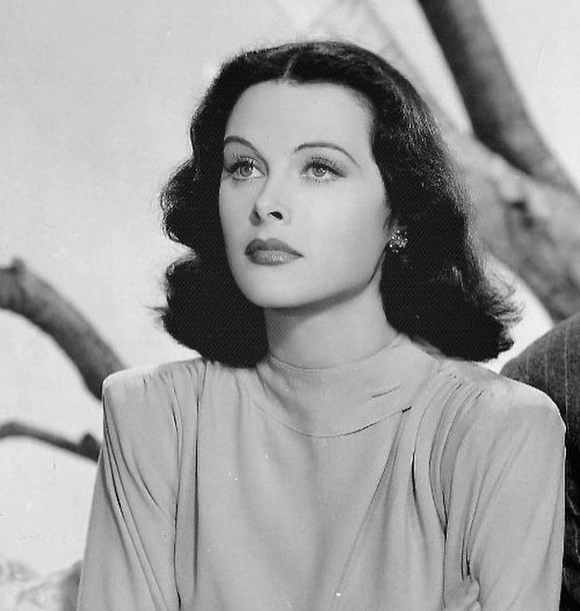
Developed a system for radio communication today that is at the core of many communications systems, including GPS and Wi-Fi
Hedy Lamarr

Slide 17
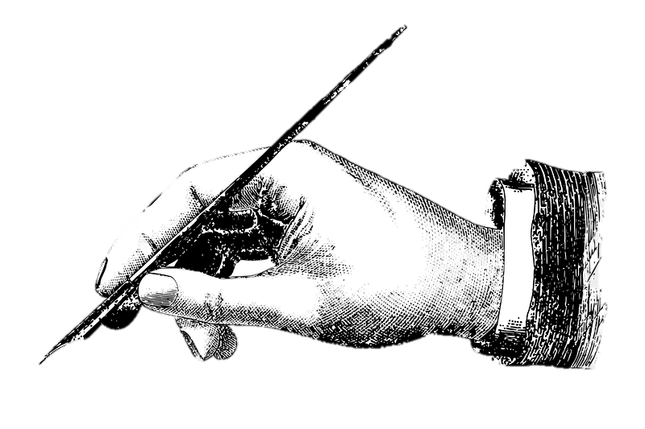
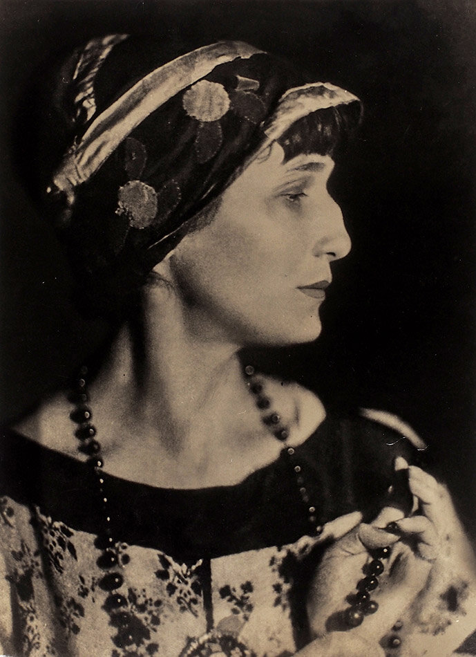
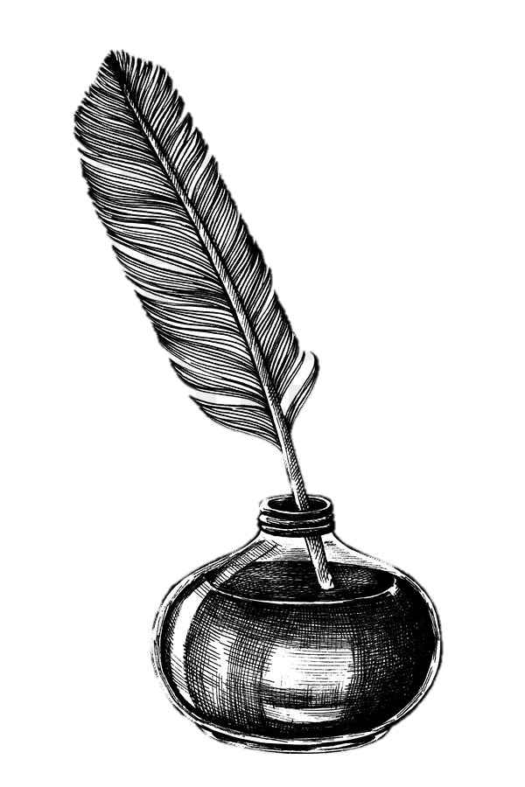
Pilot
Writer
Poet
Astronaut
Actress and inventor
Scientist
Anna Akhmatova
Volunteer
Doctor

Slide 18
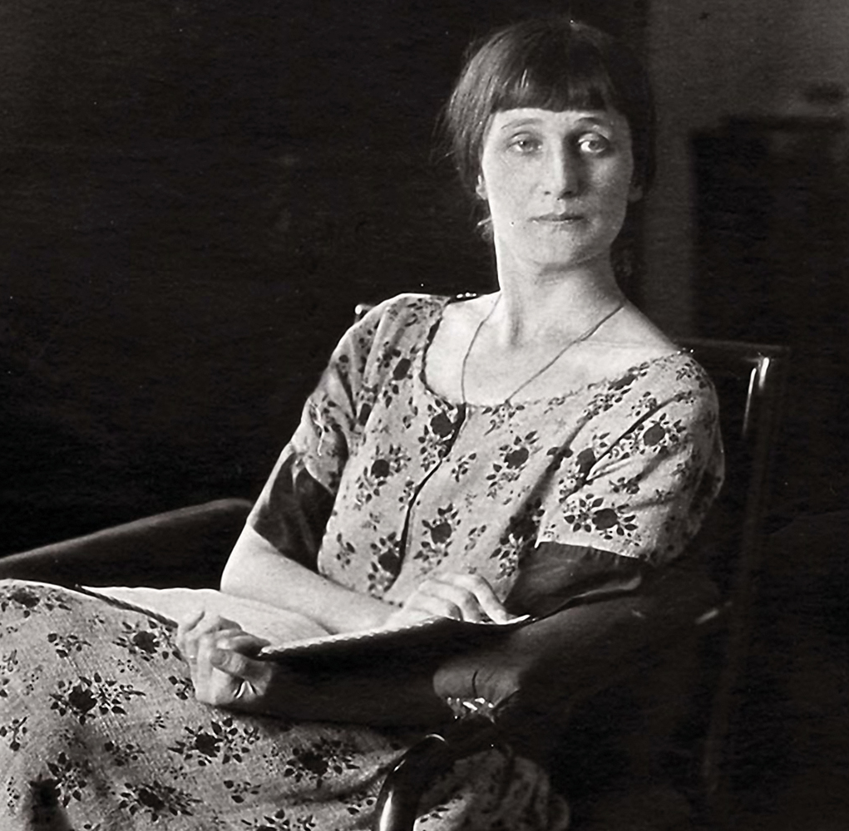
One of the most significant Russian poets of 20th century
Anna Akhmatova

Slide 19
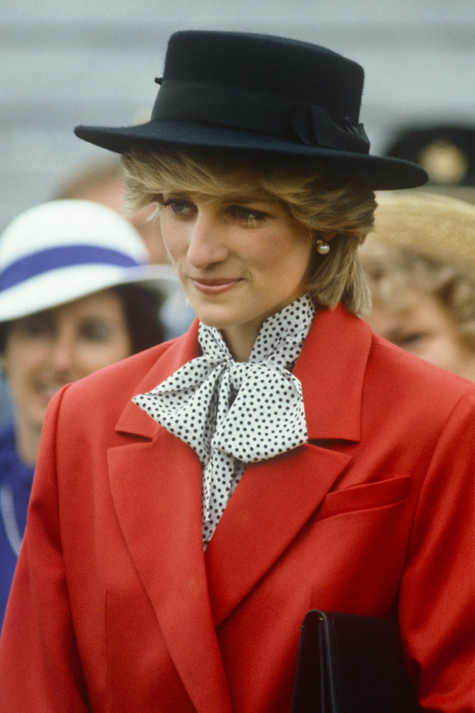

Pilot
Writer
Poet
Astronaut
Actress and inventor
Scientist
Volunteer
Princess Diana
Doctor

Slide 20
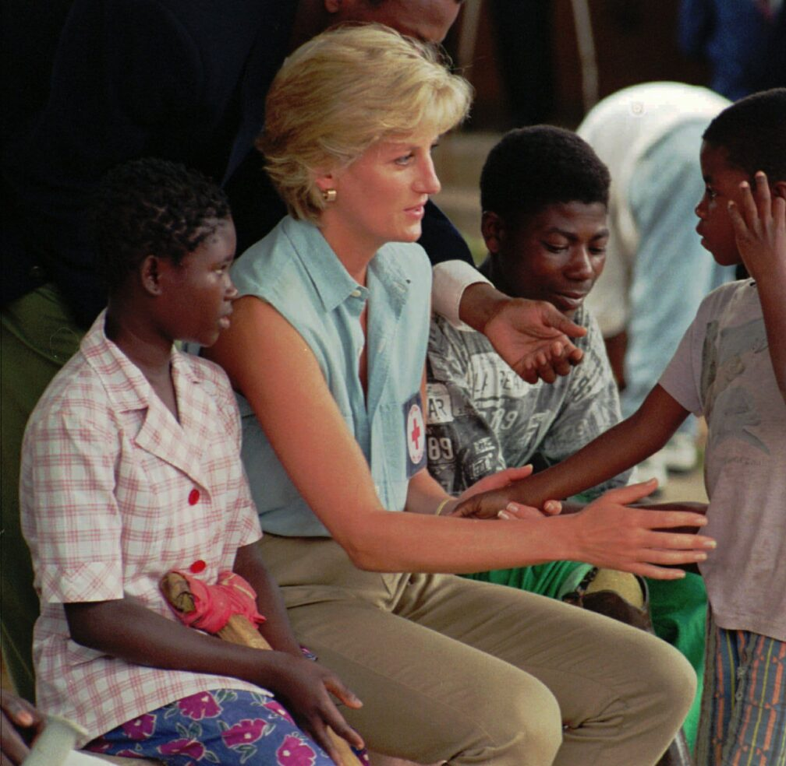
She was a volunteer and helped many people around the world
Princess Diana

Slide 21
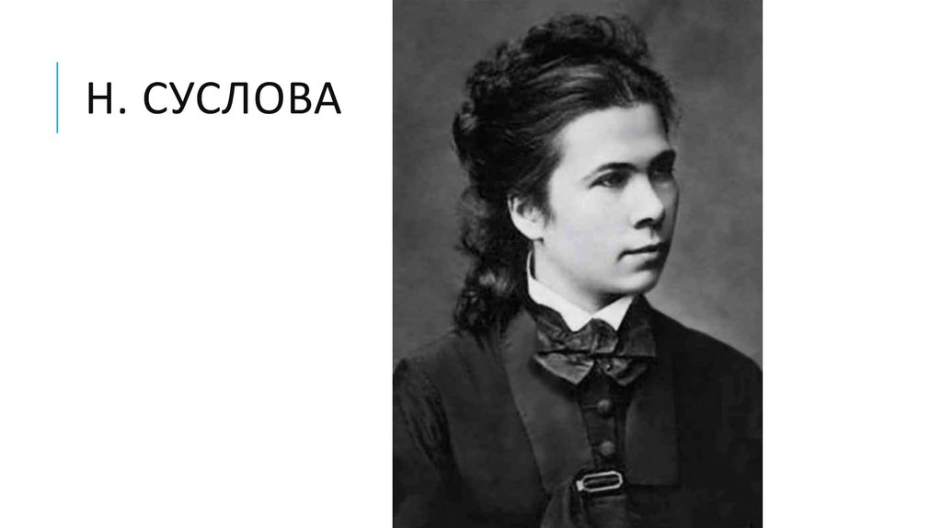

Pilot
Writer
Poet
Astronaut
Actress and inventor
Scientist
Nadezhda Suslova
Volunteer
Doctor

Slide 22
The first Russian female doctor
Nadezhda Suslova

Slide 23
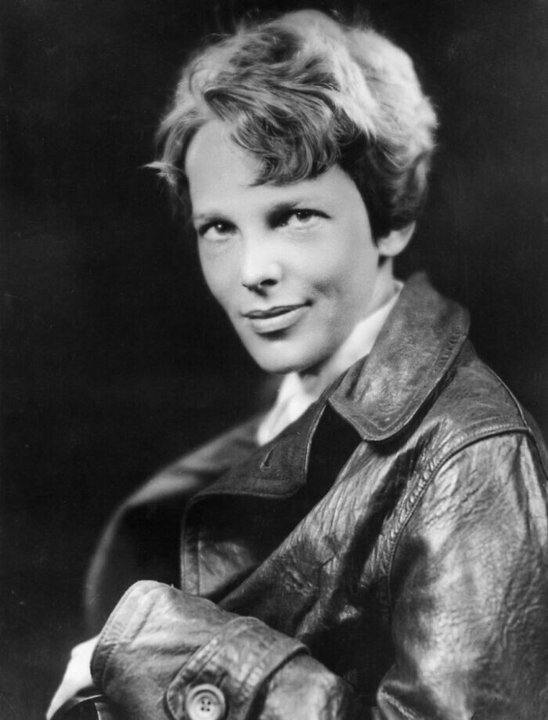
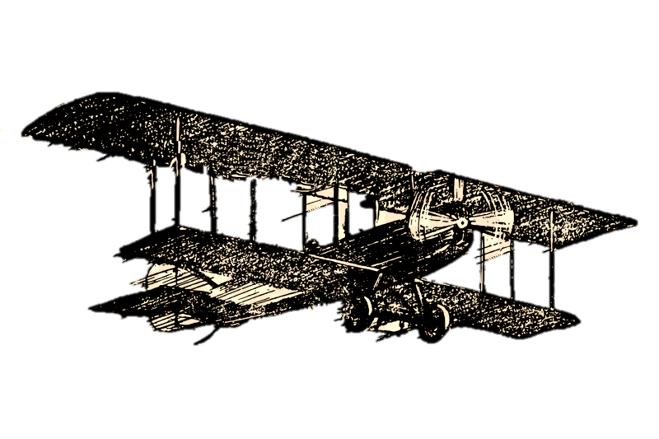
Pilot
Writer
Poet
Astronaut
Actress and inventor
Scientist
Volunteer
Amelia Earhart
Doctor

Slide 24
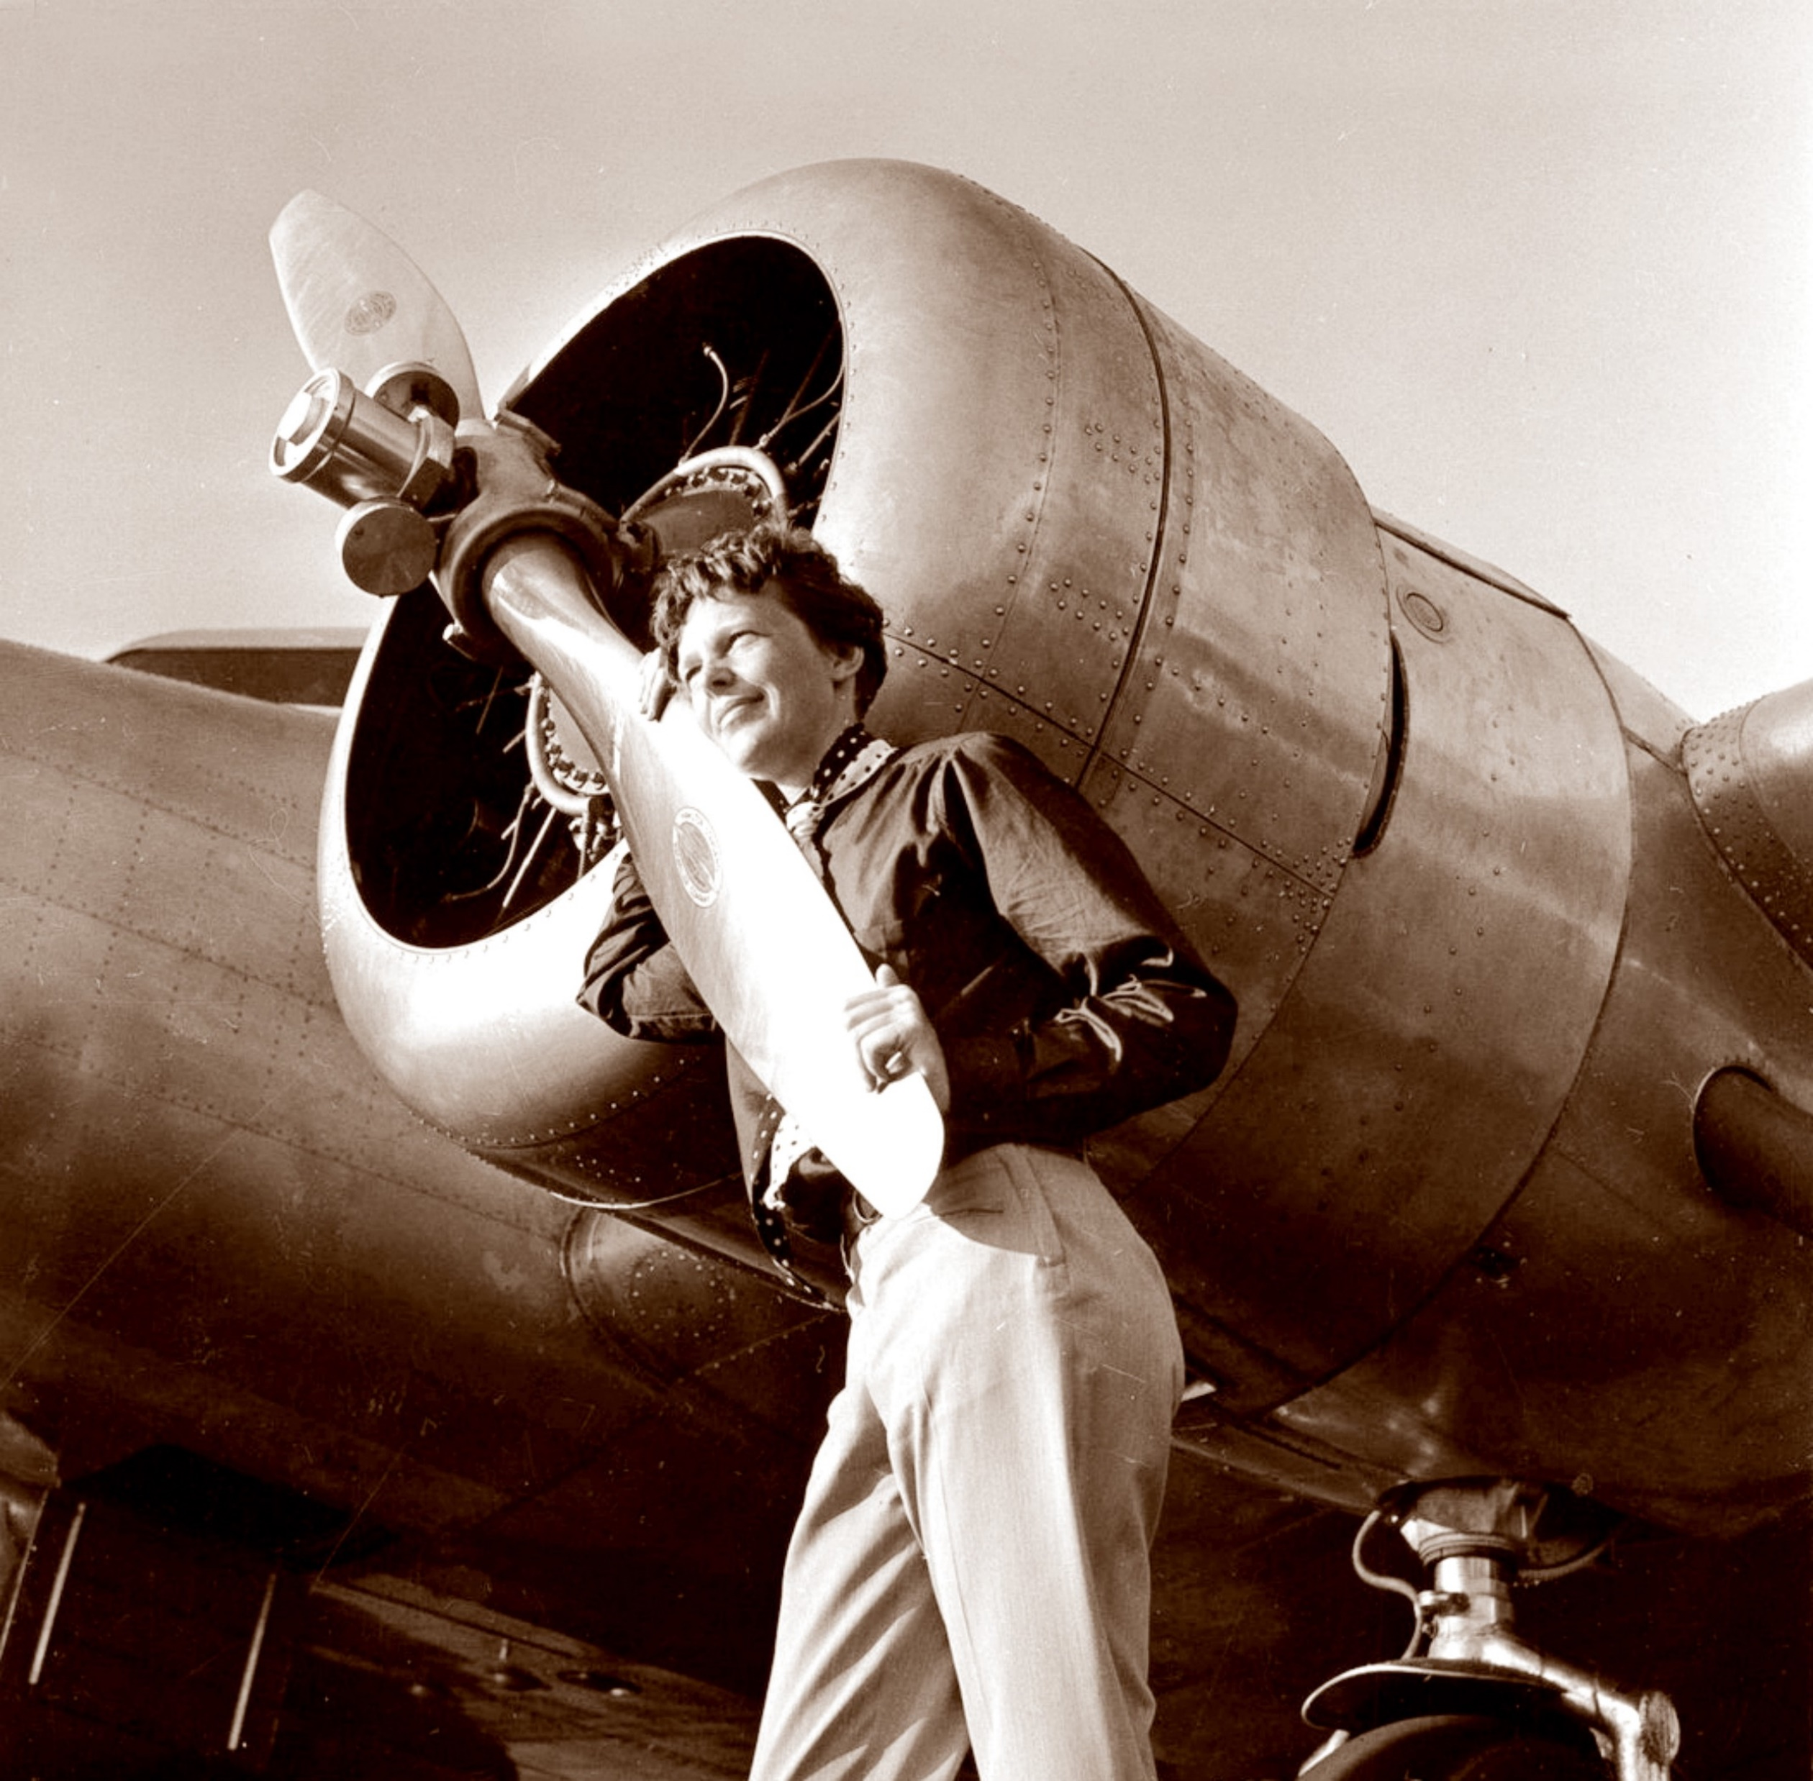
My Wonder Woman
She was the first female aviator to fly solo across the Atlantic Ocean
Amelia Earhart

Slide 25

My Wonder Woman
Grand-
mother

