Slide 1

My happy family can fly

Slide 2
Fly, bye, sunny, my, windy, funny, eye, spy, happy, baby
ai | i
fly
sunny
bye
windy
my
funny
eye
happy
spy
baby

Slide 3
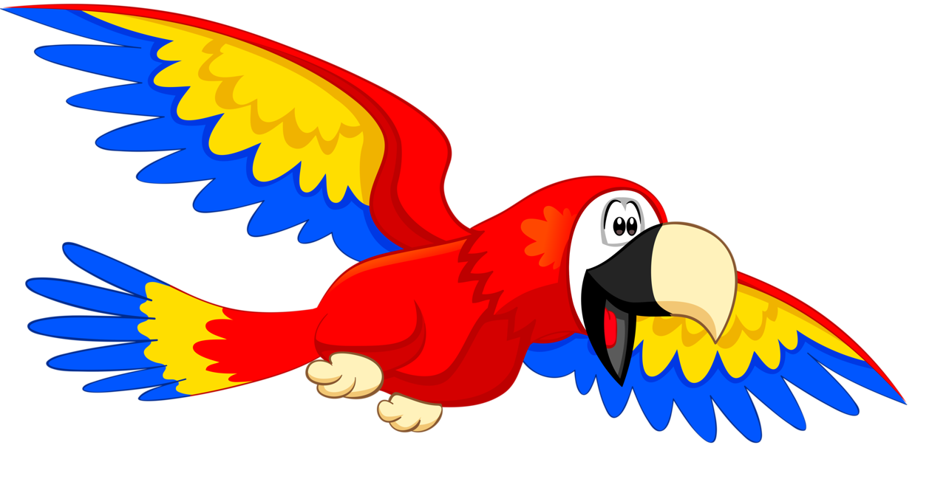
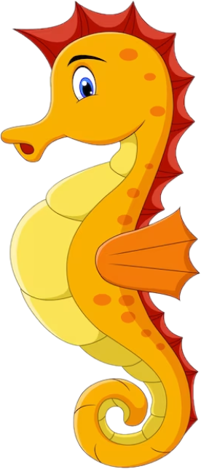
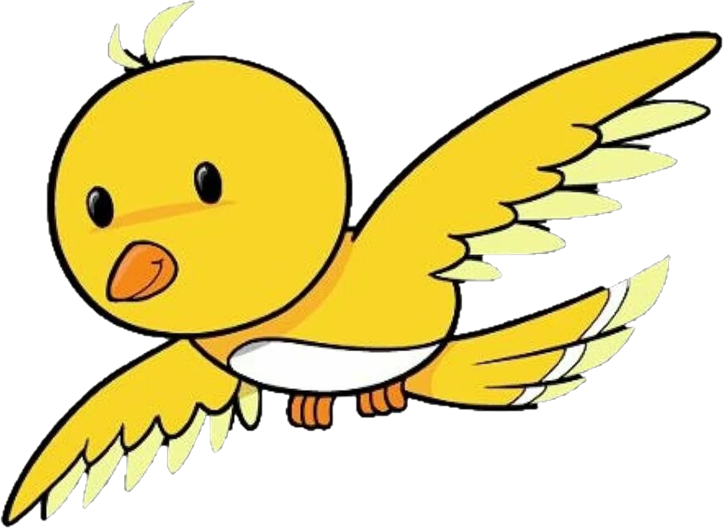


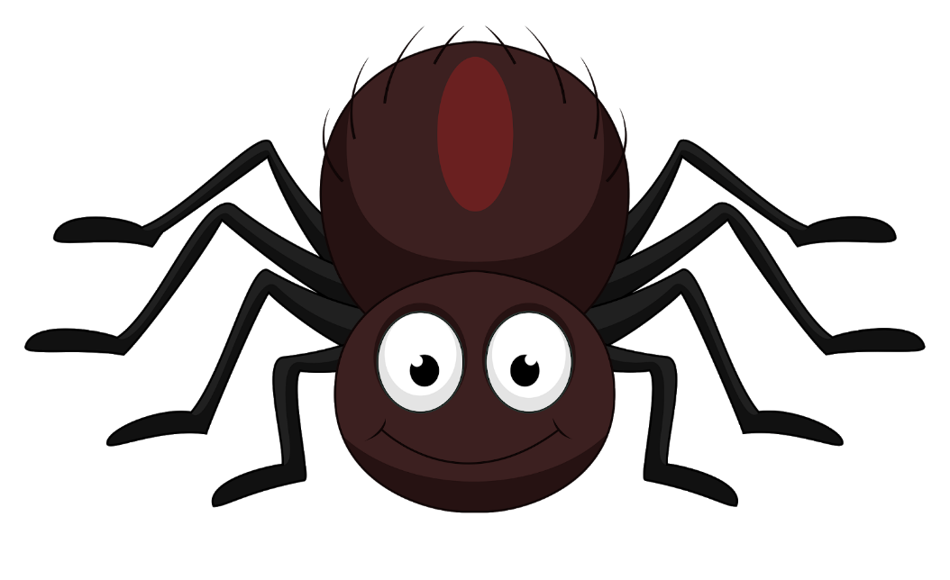
Clever animals

Slide 4
parrot

Slide 5
bird

Slide 6
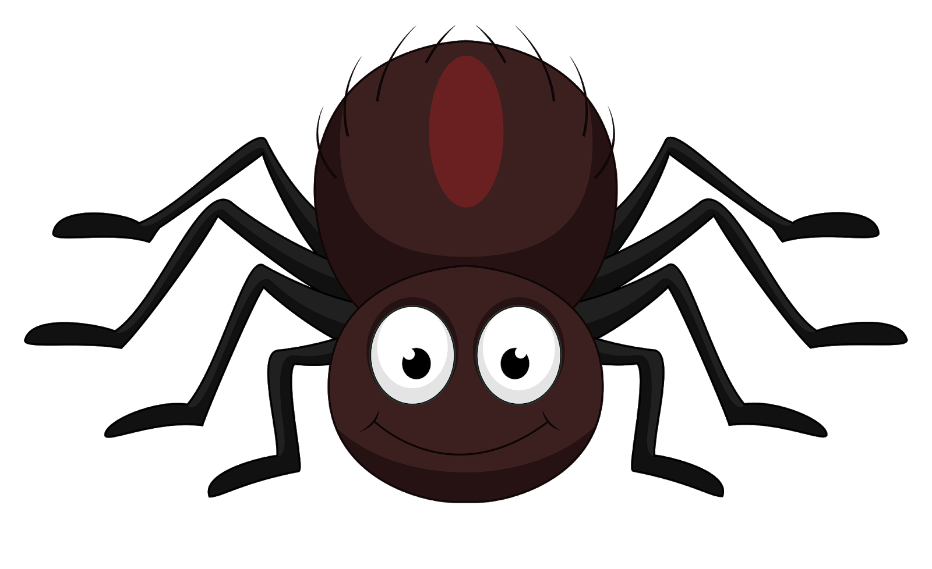
spider

Slide 7
rabbit

Slide 8
tortoise

Slide 9
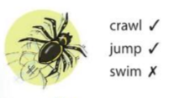
Spiders can crawl and jump, but they can`t swim.

Slide 10
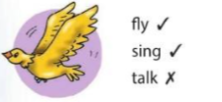
Birds can fly and sing, but they can`t talk.

Slide 11
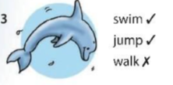
Dolphins can swim and jump, but they can`t walk.

Slide 12
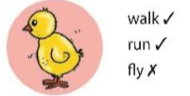
Chicks can walk and run, but they can`t fly.

Slide 13
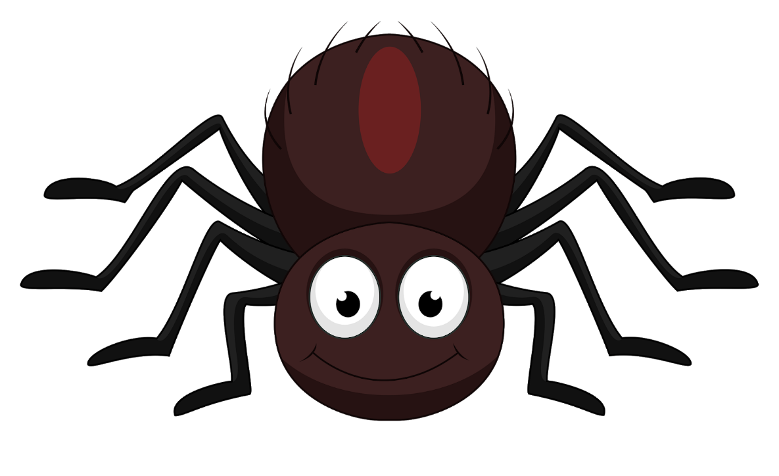
Crawl (v)
Run (v)
Sing (x)
Spiders can crawl and run, but they can`t sing.

Slide 14
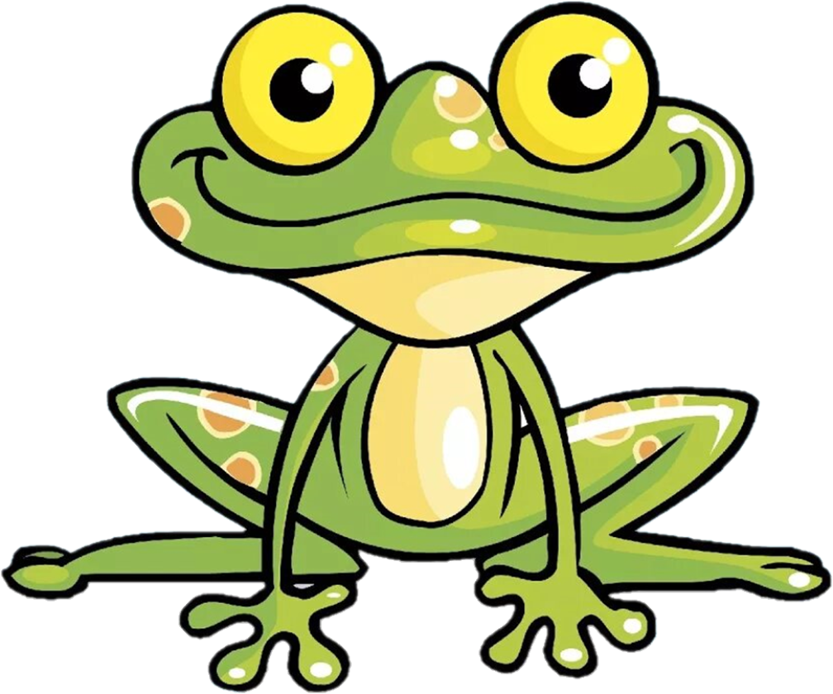
Jump (v)
Swim (v)
Fly (x)
Frogs can jump and swim, but they can`t fly.

Slide 15


Slide 16
Spiders can crawl.
Can spiders crawl?

Slide 17
Can spiders crawl?
Yes, they can
No, they can`t

Slide 18
