Slide 1

Healthy way of life

Slide 2

How to be healthy
I want to give you some simple advice how to be healthy

Slide 3

A healthy mind in a healthy body

Slide 4
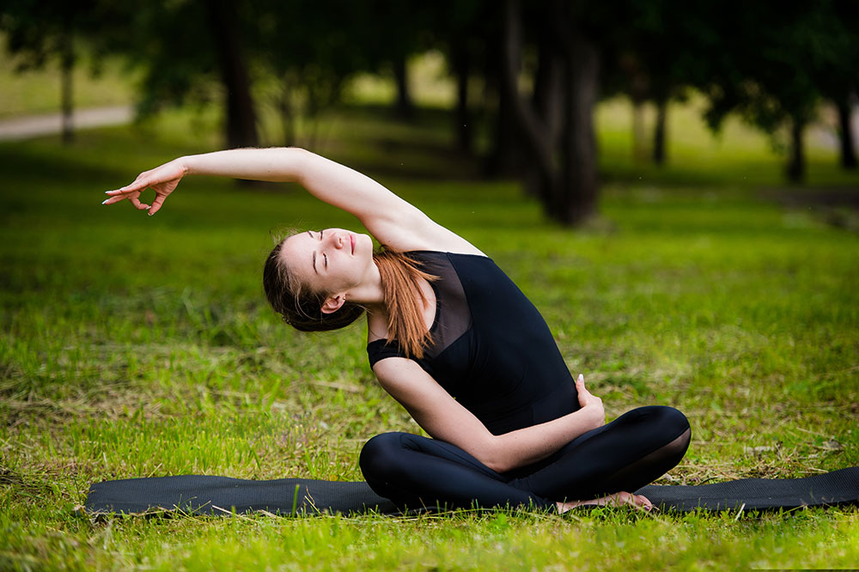
A healthy lifestyle is always useful and interesting.

Slide 5
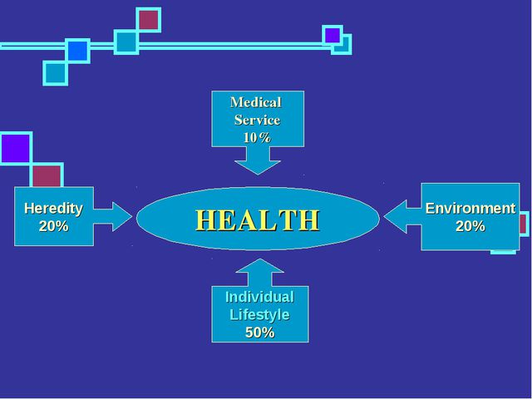

Slide 6
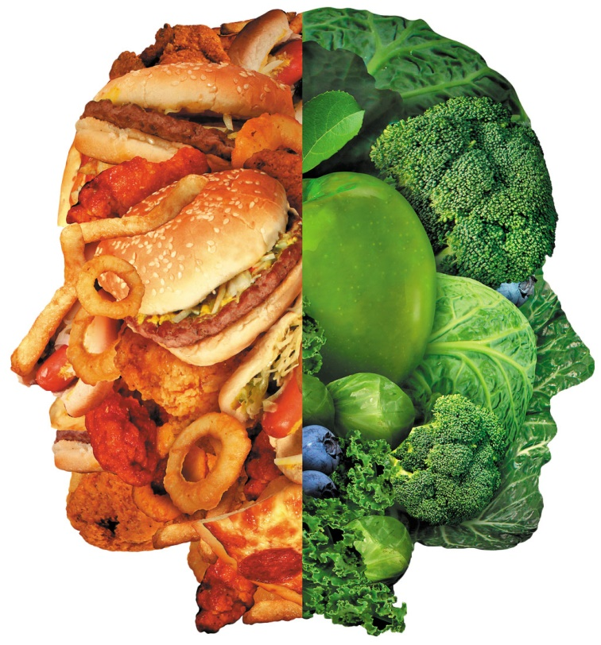
The main reasons to lead a healthy lifestyle
1. Improve your health and boost immunity.
2. Get rid of stress and depression.
3. Have a beautiful, toned body and keep youth.
4.Every morning wake up full of strength and energy.
5.Enjoy every new day, and always be in a good mood.

Slide 7
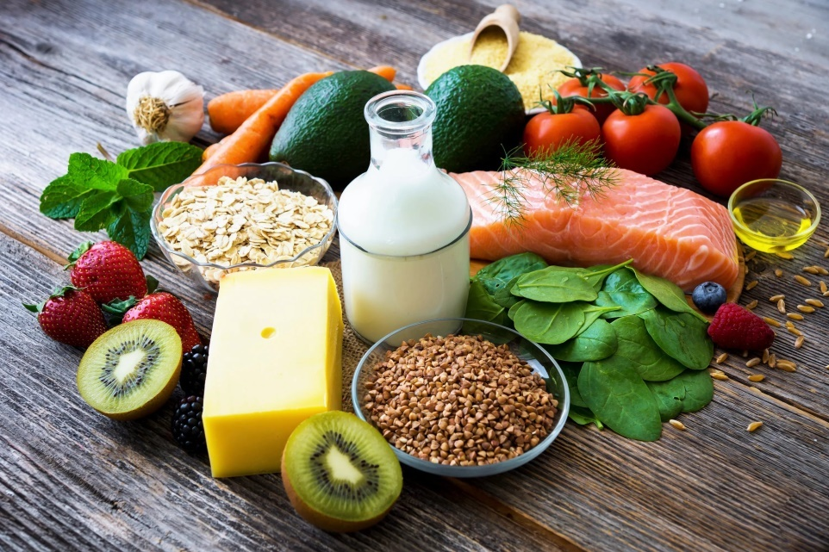
The basic food
One more thing to know is that when food is cooked, its structure changes. It can change the vitamin and nutrient contents of food.
More and more people feel strongly about the way, their food is produced. Nowadays so much of the basic food we eat — meat, fish, fruit and vegetables — is grown using chemicals and additives.

Slide 8
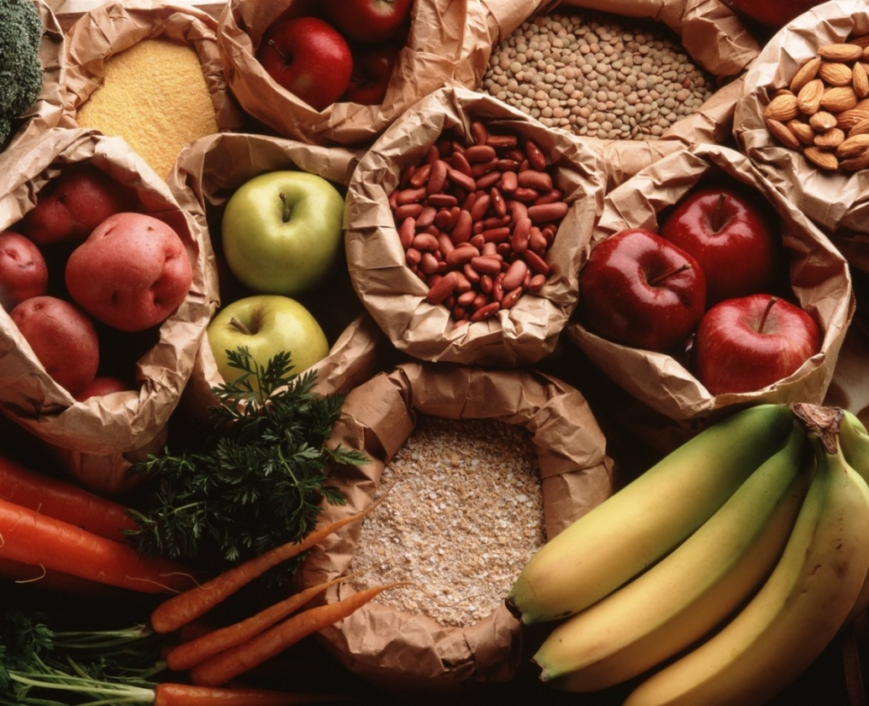
Secrets of healthy eating
Eating a healthy diet is a part of healthy lifestyle. You should eat more fruit and vegetables.

Slide 9


The proverb says: “An apple a day keeps a doctor away”

Slide 10

Healthy nutrition
Healthy nutrition is nutrition that ensures the growth, normal development and livelihoods of a person, contributing to his health and disease prevention.

Slide 11
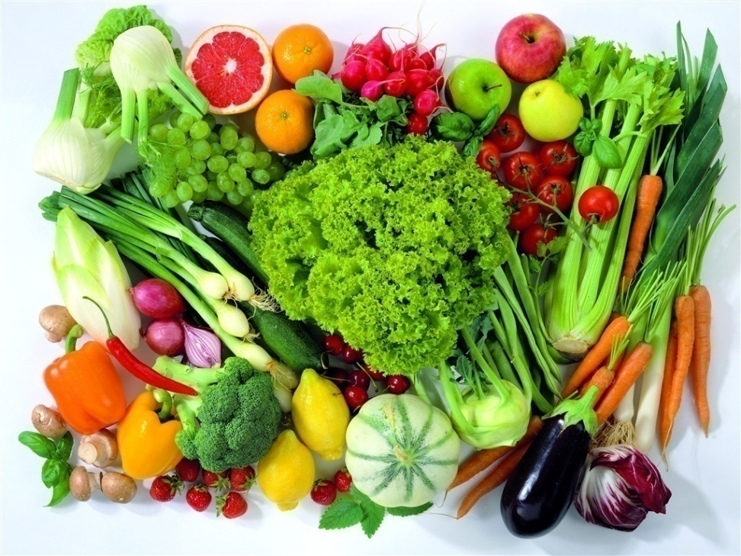
Top 10 useful Foods:
1. Eggs
2. Yogurt
3. Nuts
4. Kiwi
5. Fish
6. Beans
7.Salmon
8.Broccoli
9. Sweet potato
10. Berries

Slide 12
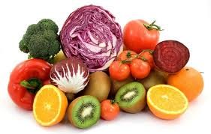
Healthy Food
Fruits
Vegetables
Fish
Honey
Nuts
Fibre
Wholemeal bread
Low-fat-food
Juice

Slide 13

Unhealthy Food
Fast food
Junk food
Fresh bread
Meat
High fat-food
Sweets
Snacks
Cakes
Coca-cola

Slide 14

Eat enough fruits and vegetables
Eat enough fruits and vegetables to give your body enough vitamins.

Slide 15

Limit the consumption of salt, sugar.
Limit the consumption of salt, sugar, and other harmful auxiliary products – ketchup, mayonnaise, various sauces, because most often they contain harmful additives.

Slide 16
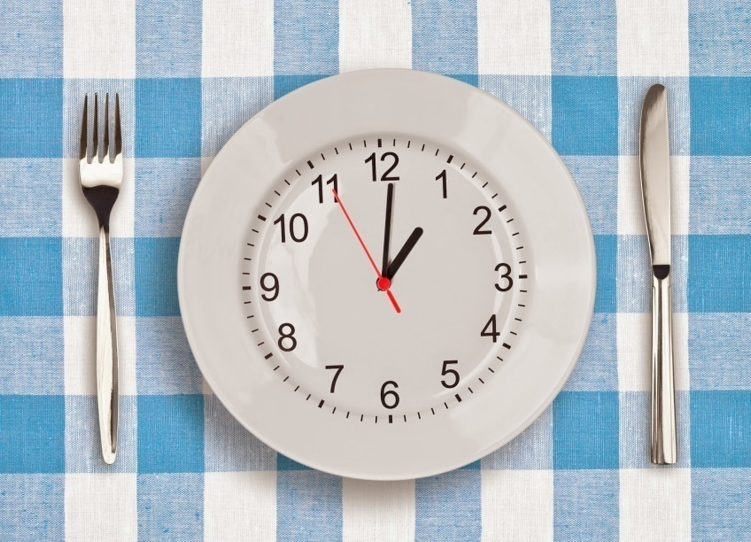
The regime
The regime of eating is also important. It means we need to eat at certain hours during the day. For example, breakfast at 8 am, lunch at 1 pm, snack at 4 pm and dinner at 6 pm. Along with eating healthy, we should try to keep fit by doing exercise, cycling, spending less time in front of the TV and not smoking.

Slide 17
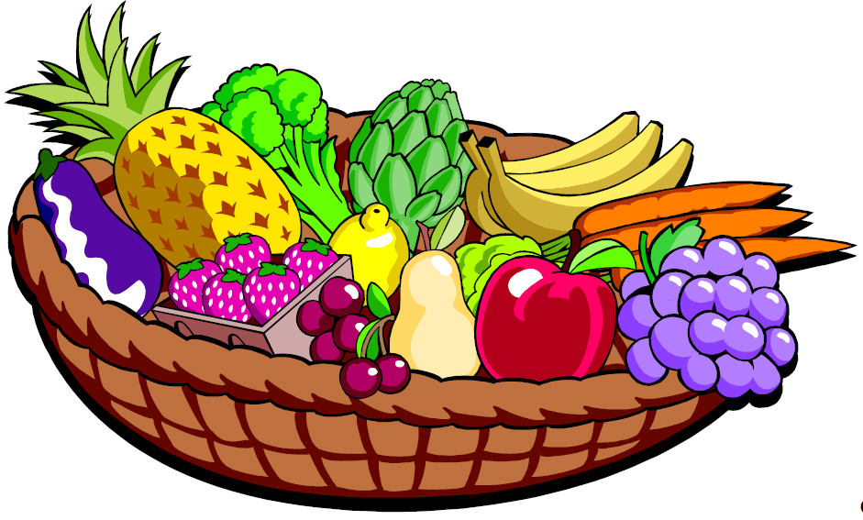
The regime of eating
Try to eat as often as possible and in small portions, for example,
breakfast, lunch and dinner split into 2 meals, in the end you get 6 meals a day.

Slide 18

Exercising is necessary for a healthy life
Exercising is necessary for a healthy life, but don’t overdo
with it!
Exercising makes you feel well
Exercising in fresh air is good
for brain
Exercising relieves stress, helps to overcome troubles and makes you happy

Slide 19

Exercise
Make sure to exercise for at least 30 minutes every morning! In addition to the General warm-up, the exercises should include several physical exercises, It is desirable to visit the gym.

Slide 20

We must eat…
First, we should eat less fat, particularly saturated fat.
Secondly, we are to cut down on sugar and salt.
Thirdly, we must eat more fresh fruit and vegetables.

Slide 21
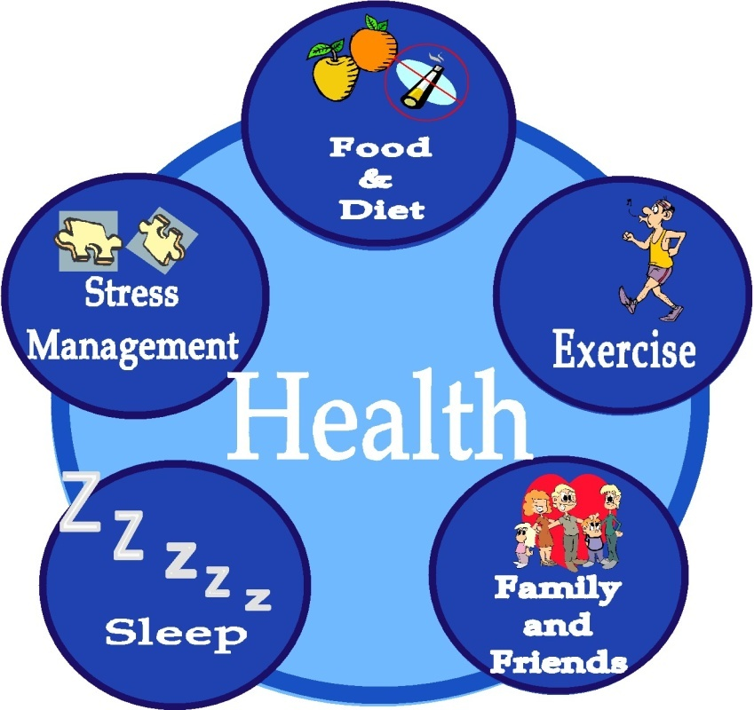

Slide 22

Sleeping is an important component of a healthy lifestyle
An average adult needs about 7-8 hours of sleep per a day
Children need to sleep more, infants sleep the most.
And most importantly – it’s pleasant to sleep.

Slide 23
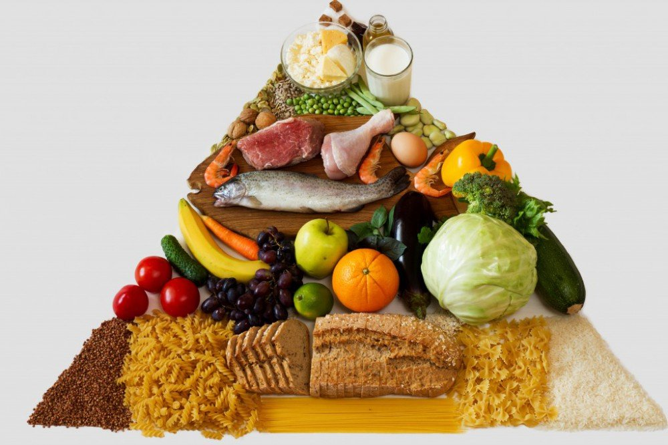
Lots of factors
The food we eat, depends on lots of things. Taste is a big factor. Culture, religion and health also play a part in what food we eat. Advertising and social factors also have a big influence.

Slide 24


Say NO

Slide 25


Say NO
Smoking can result in getting cancer.

Slide 26


Say NO

Slide 27

Say NO

Slide 28
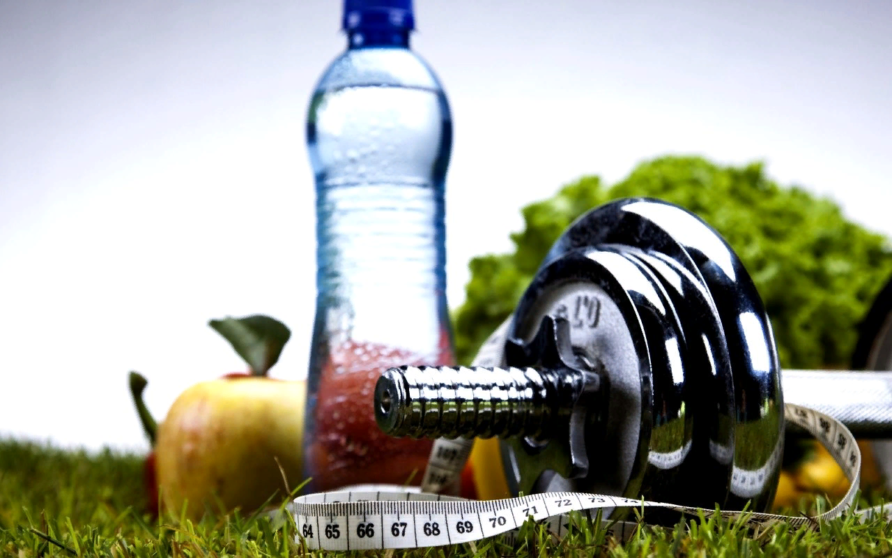
Health is above wealth

Slide 29

Do all five!
To be healthy in your life
Don`t forget to do all five!
Get up early, quick and bright
Exercise with all your might.
In the morning jump and run,
Eat your healthy breakfast.
Train your body, train your brain
And all bad habits pass away.

Slide 30

Follow my advice and be healthy!

