Slide 1

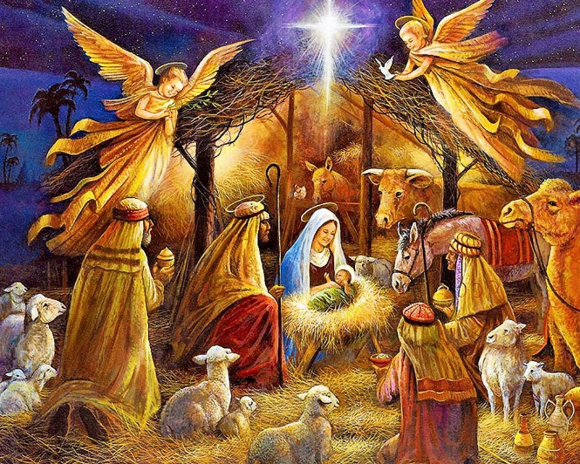
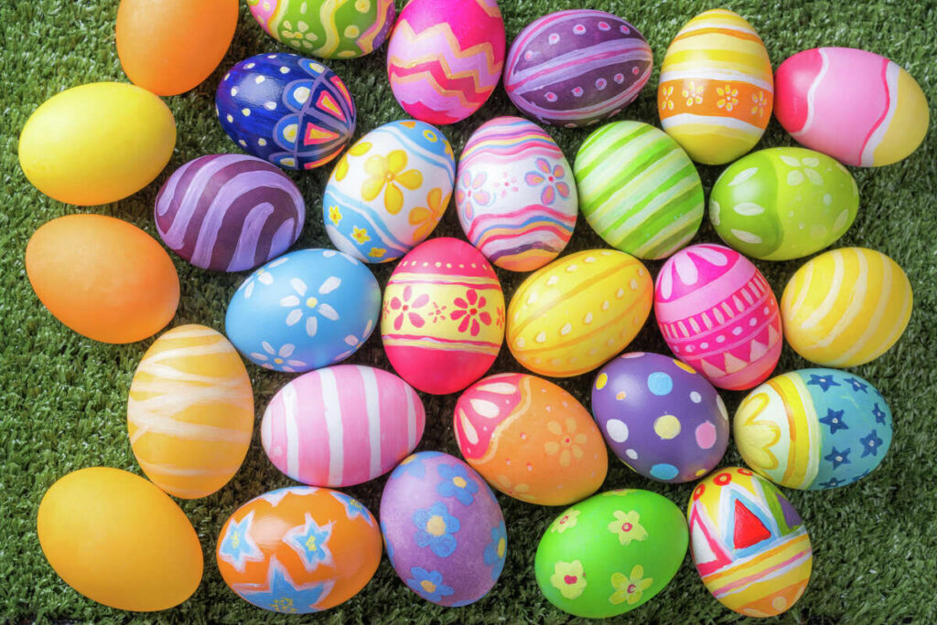

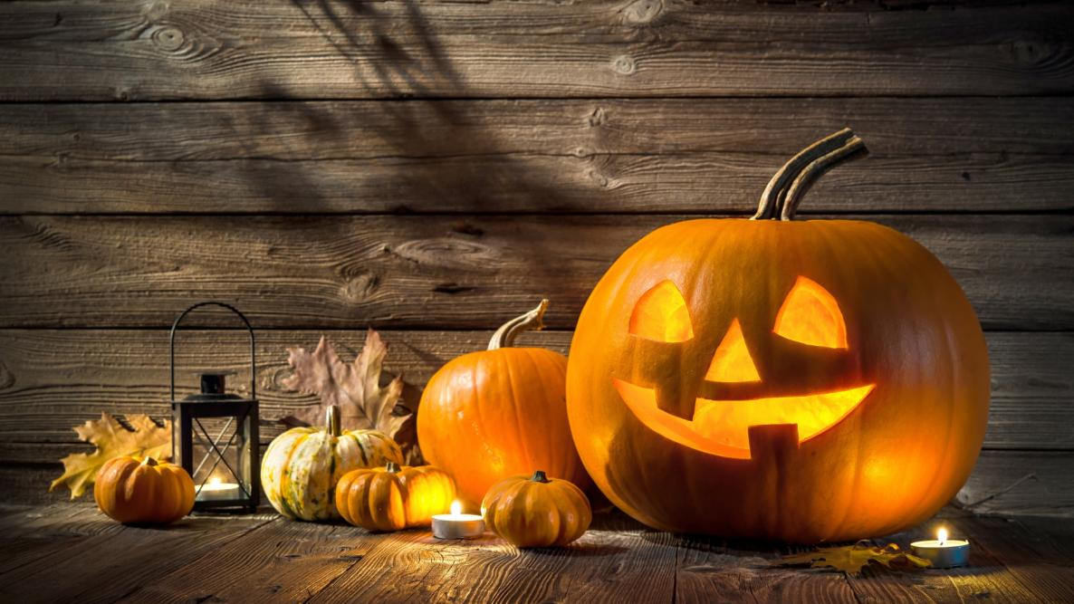

Valentine’s Day
Christmas
Easter
New Year’s Day
Halloween
April Fool’s Day

Slide 2
February, 14 / February 14th = the fourteenth of February
Valentine’s Day is on February 14th =
Valentine’s Day is on the fourteenth of February

Slide 3
March 8^{th =} the eighth of March
February 23rd
September 1st
January 1st
December 31st
February 14th
December 25th
January 7th

